Slide 1
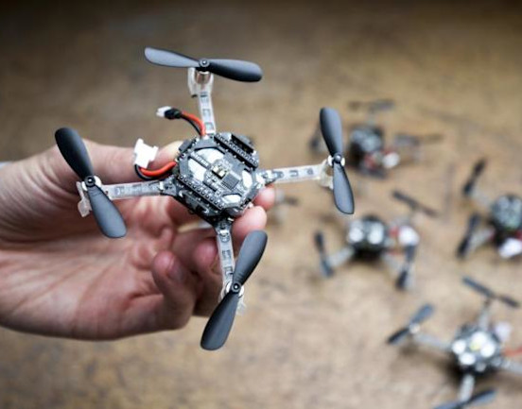
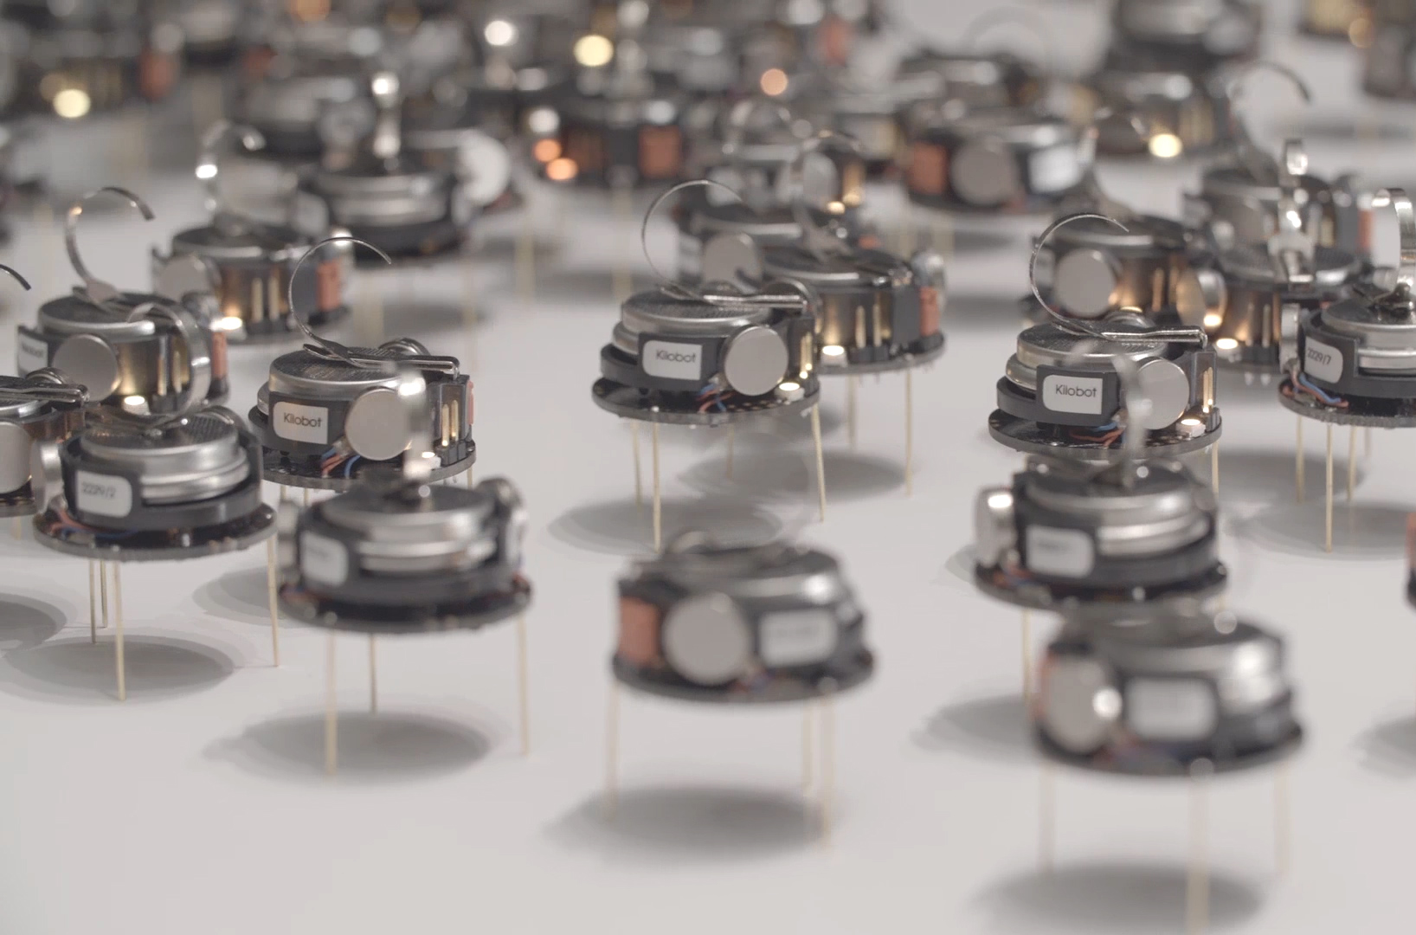
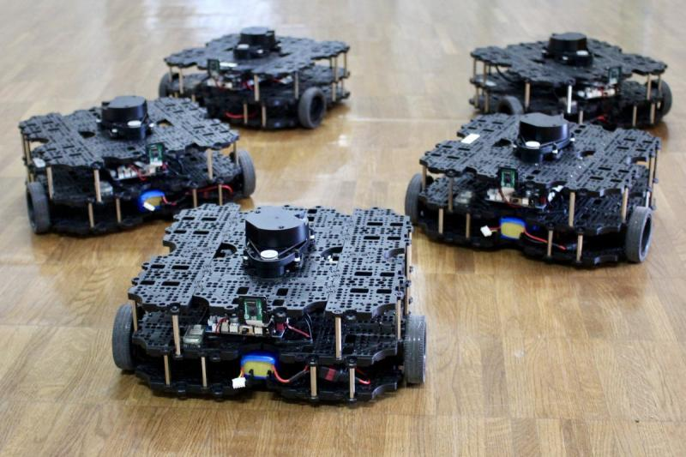

ECE693H, Spring 2025: Multi-robot System Design
“Intelligence 2”
Dr. Daniel Drew

Slide 2
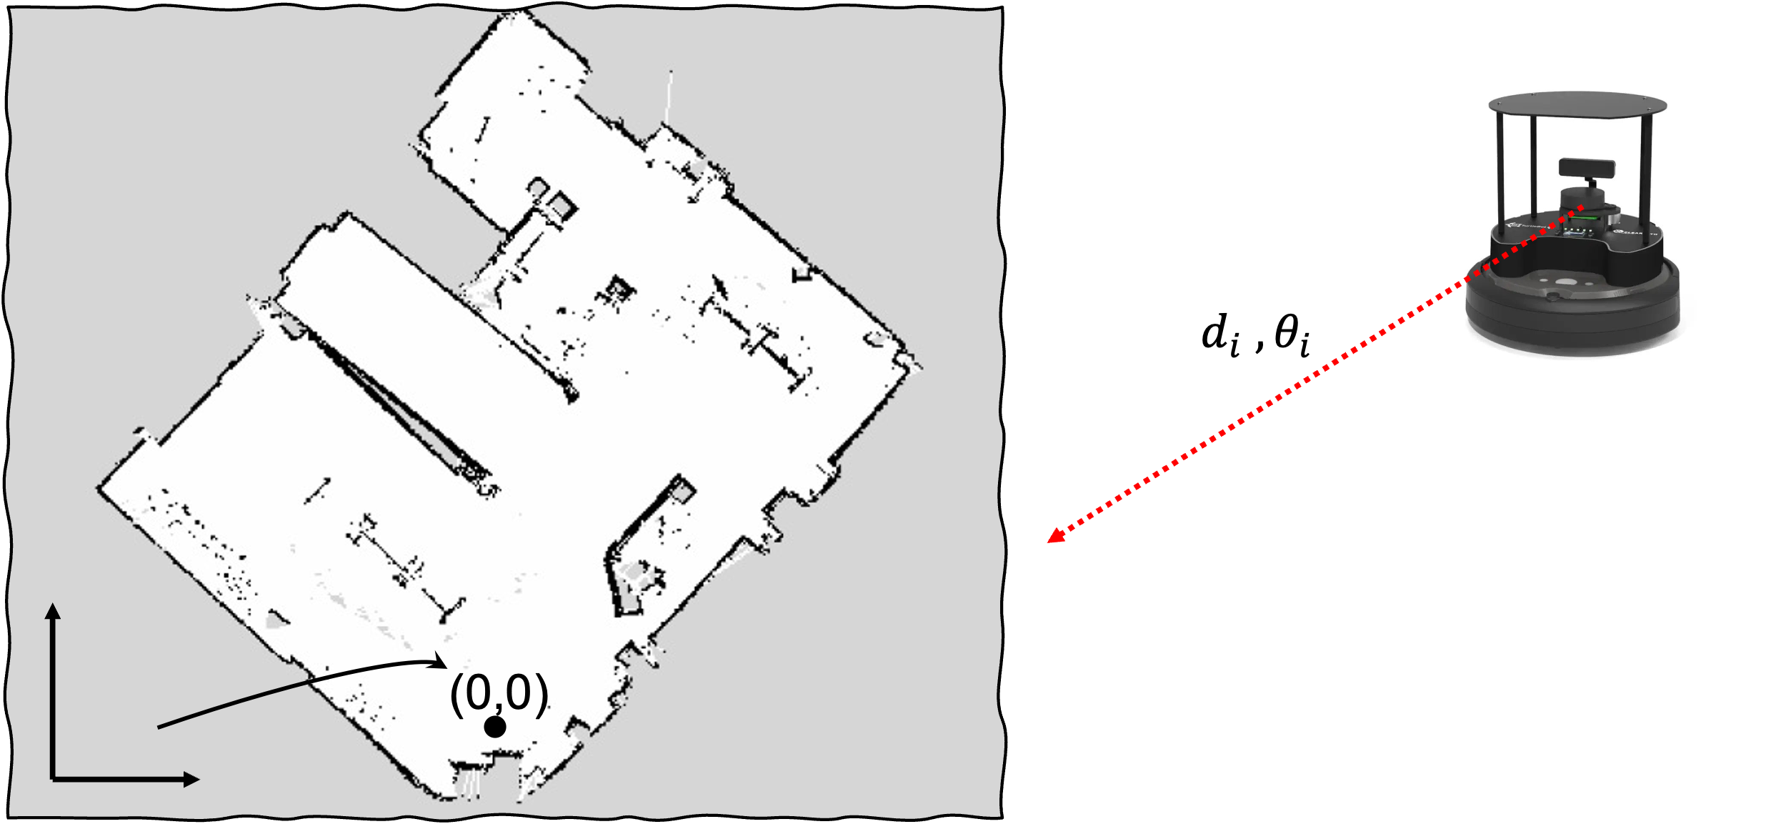
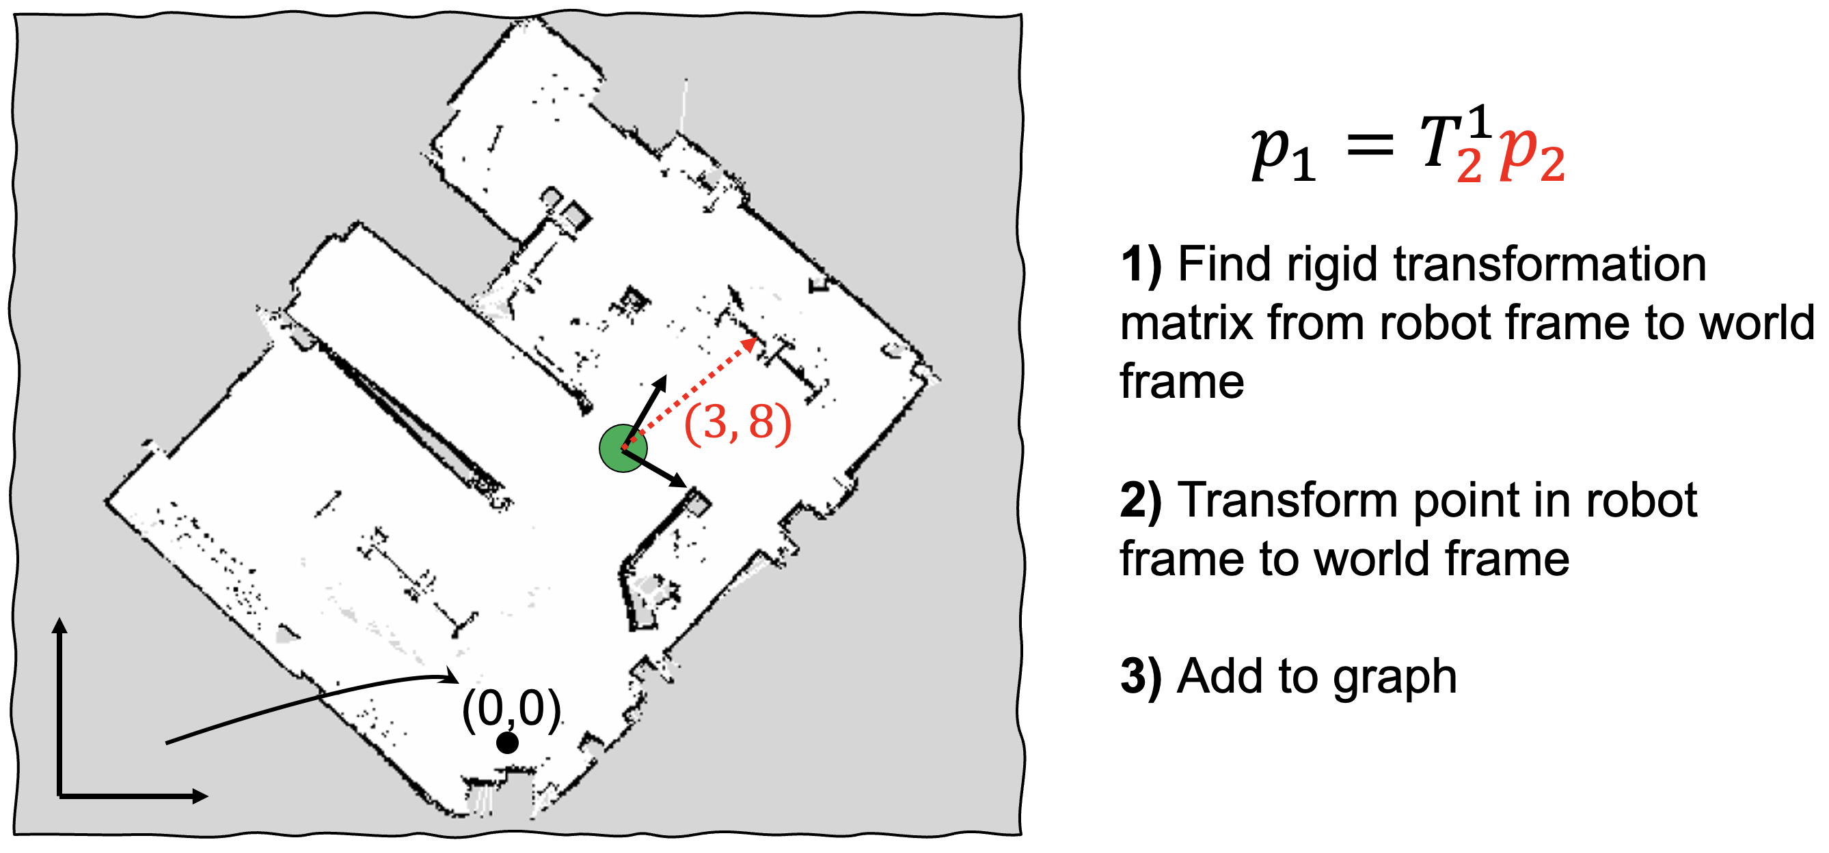
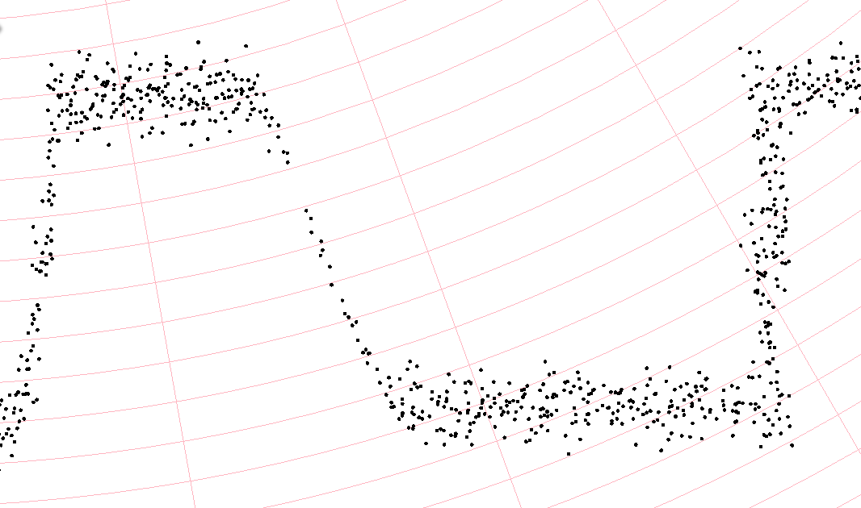
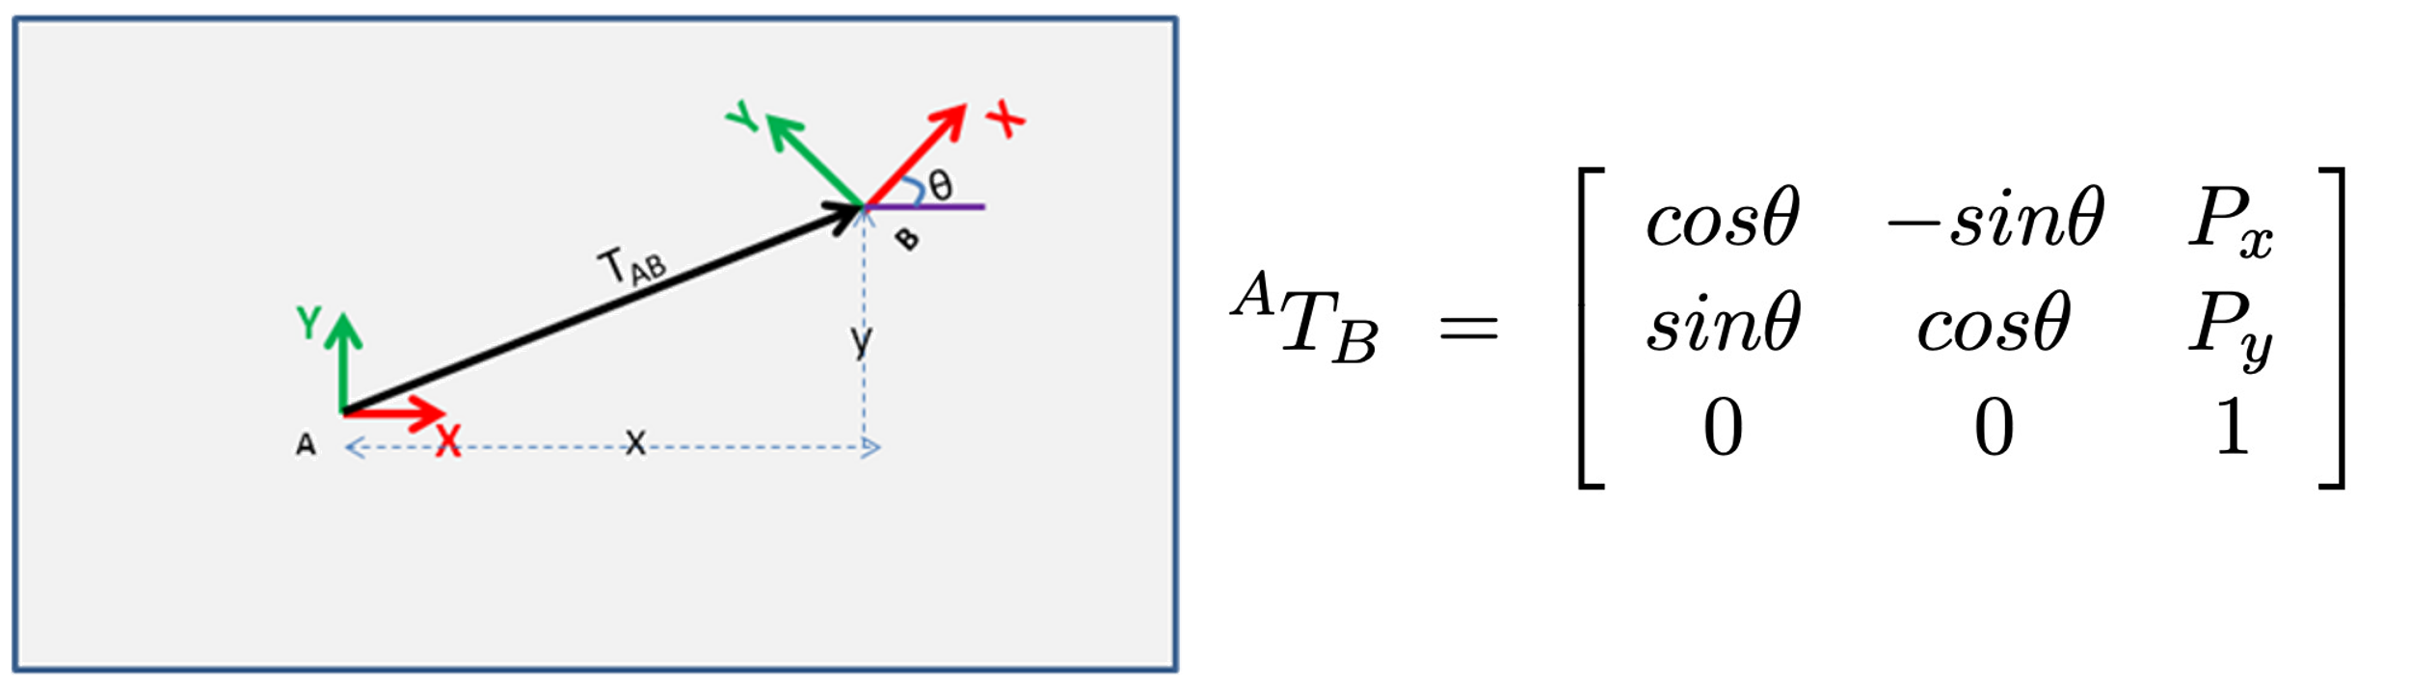
Intelligence 1 Recap

Slide 3
Questions?

Slide 4
Class Overview
Lecture (~45 minutes)
Subsystem check-in (~15 minutes)

Slide 5
Intelligence: Lecture 2 of 2
Lecture 1: features, transformations, and mapping
Lecture 2: SLAM

Slide 6
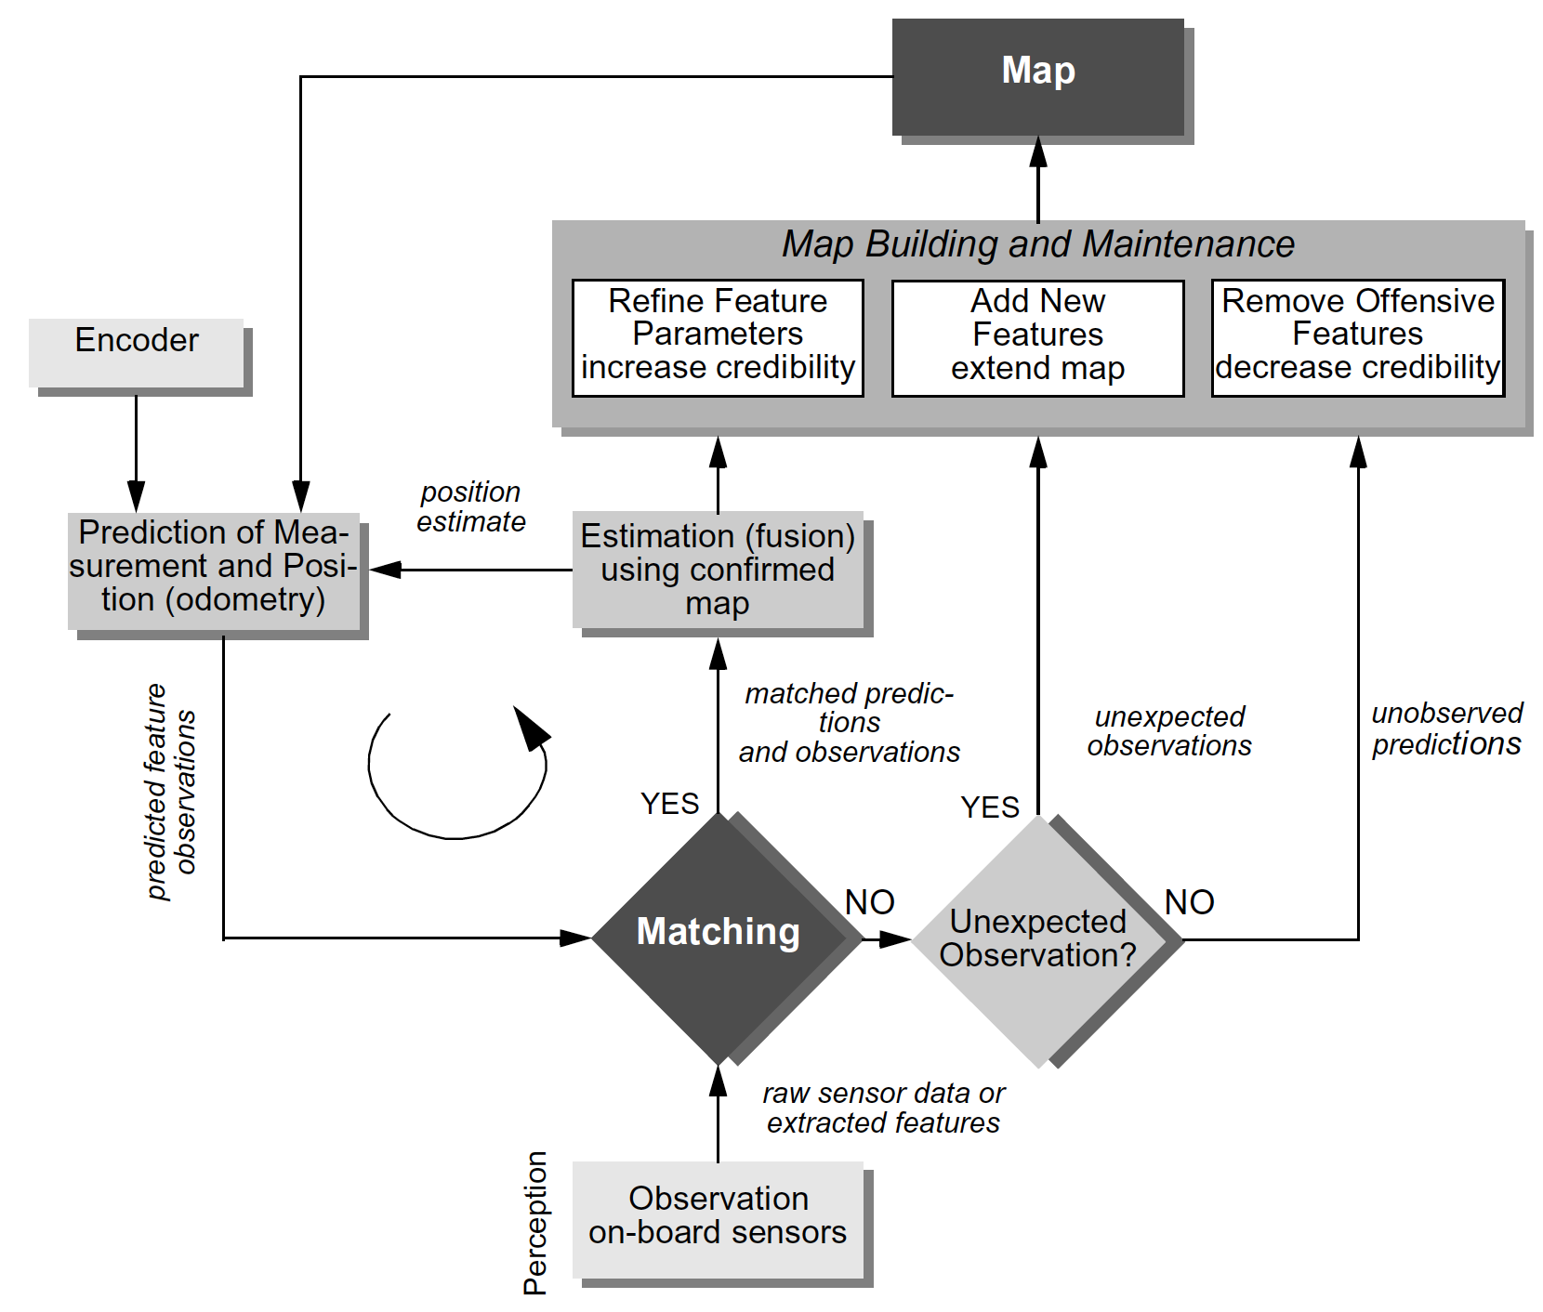
SLAM as an archetypical function
Mapping,
Feedback between Action and Perception
Localization
Perception

Slide 7
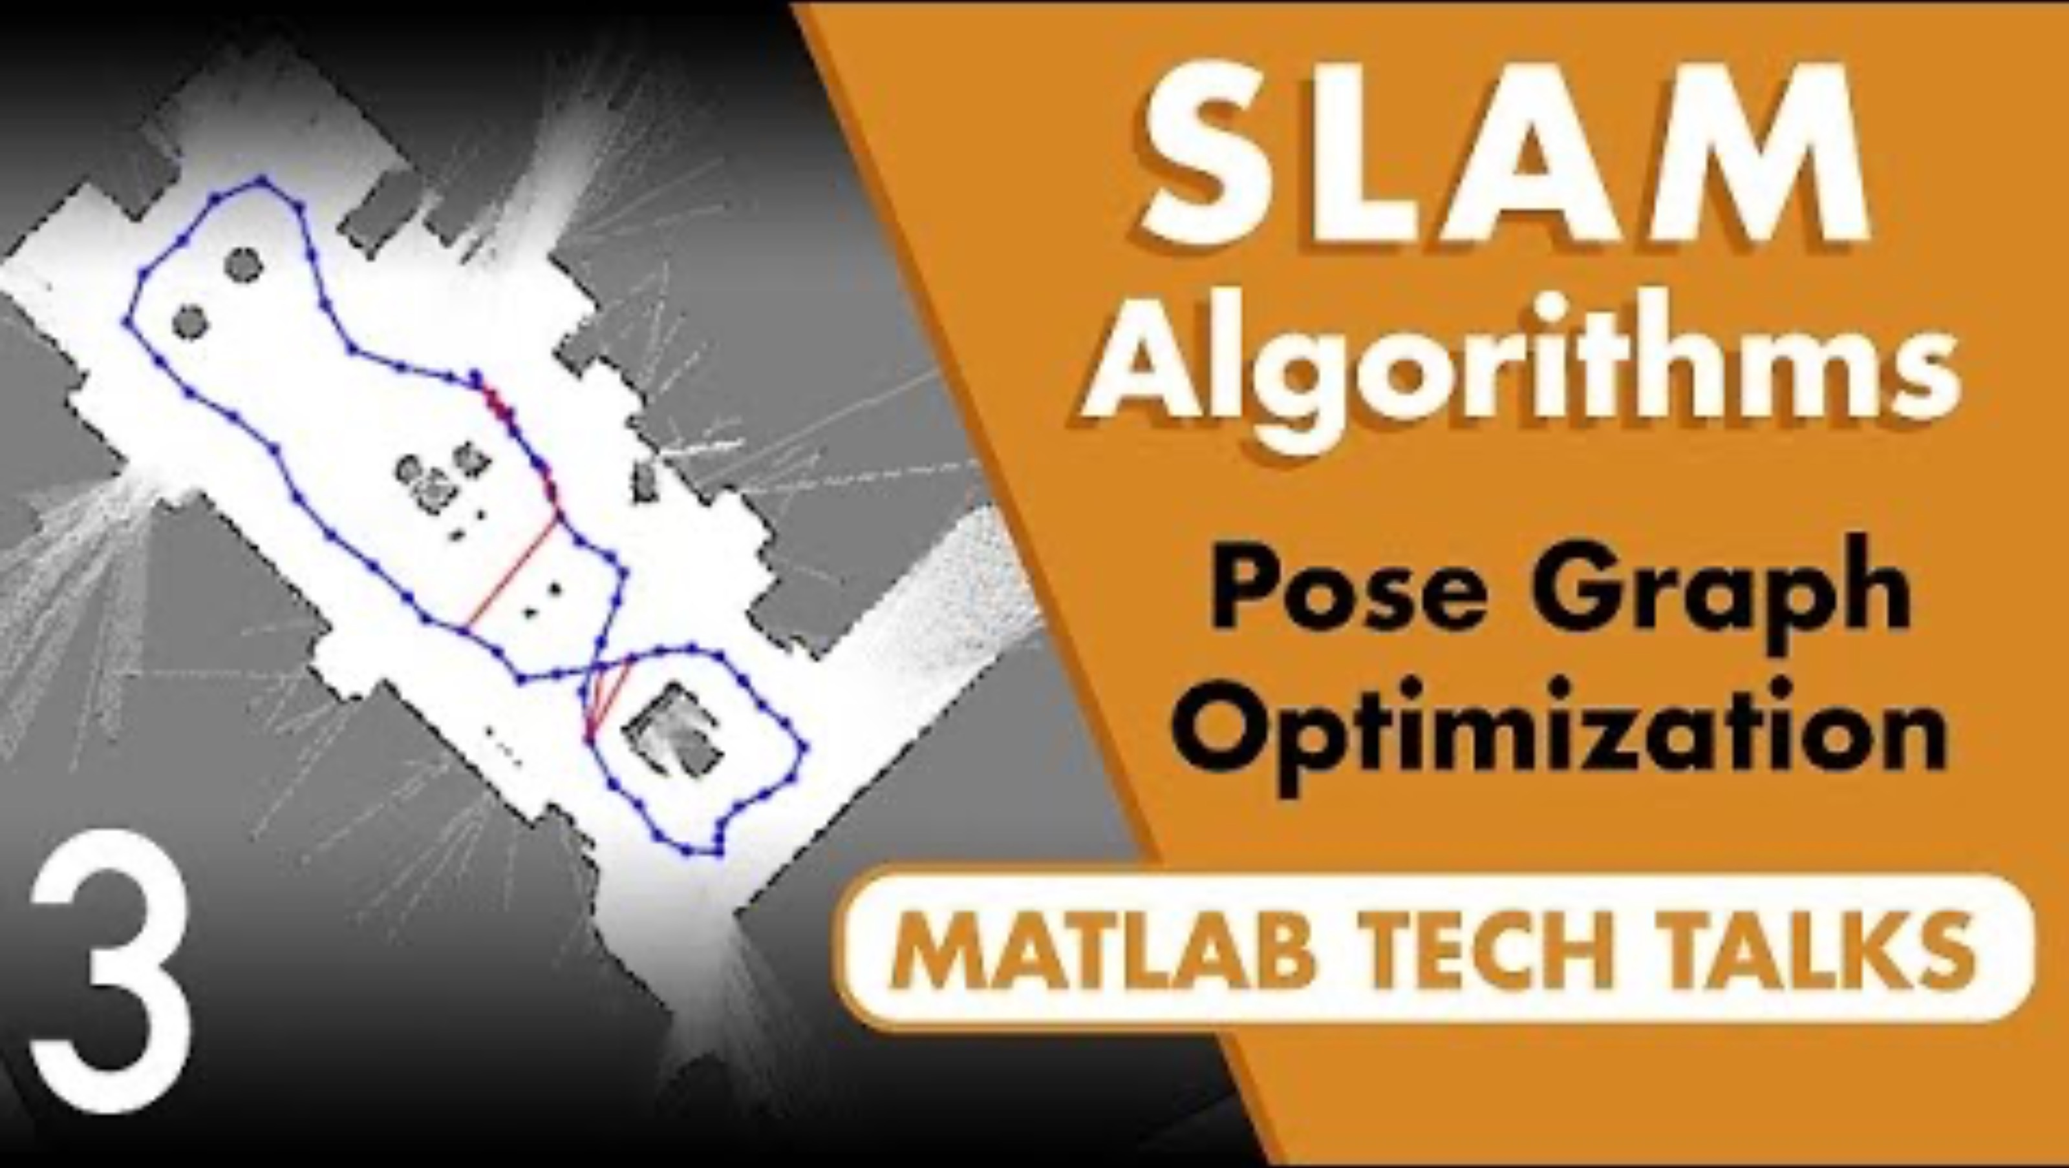
SLAM as an archetypical function
4:47

Slide 8
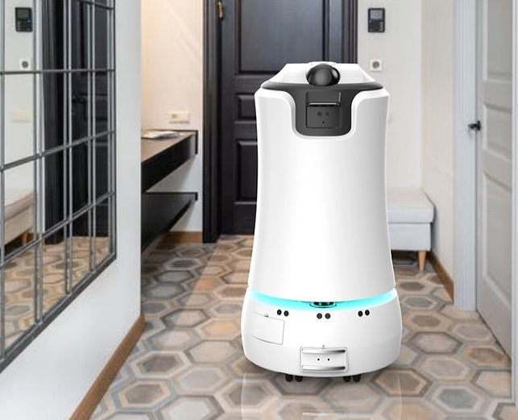
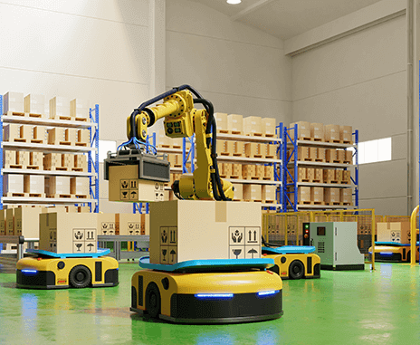
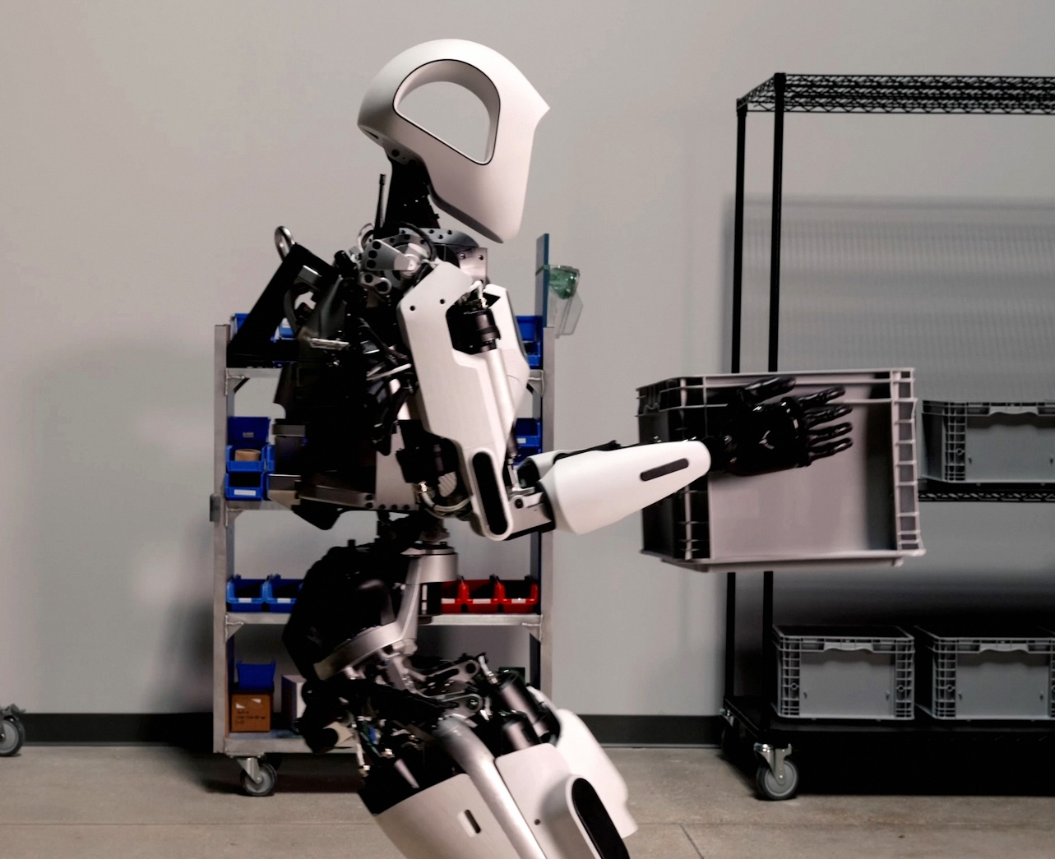
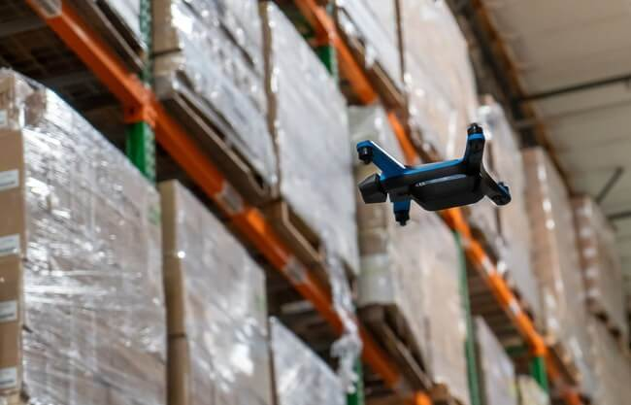
SLAM in the wild
Essential almost any time autonomous mobile robots are used!

Slide 9
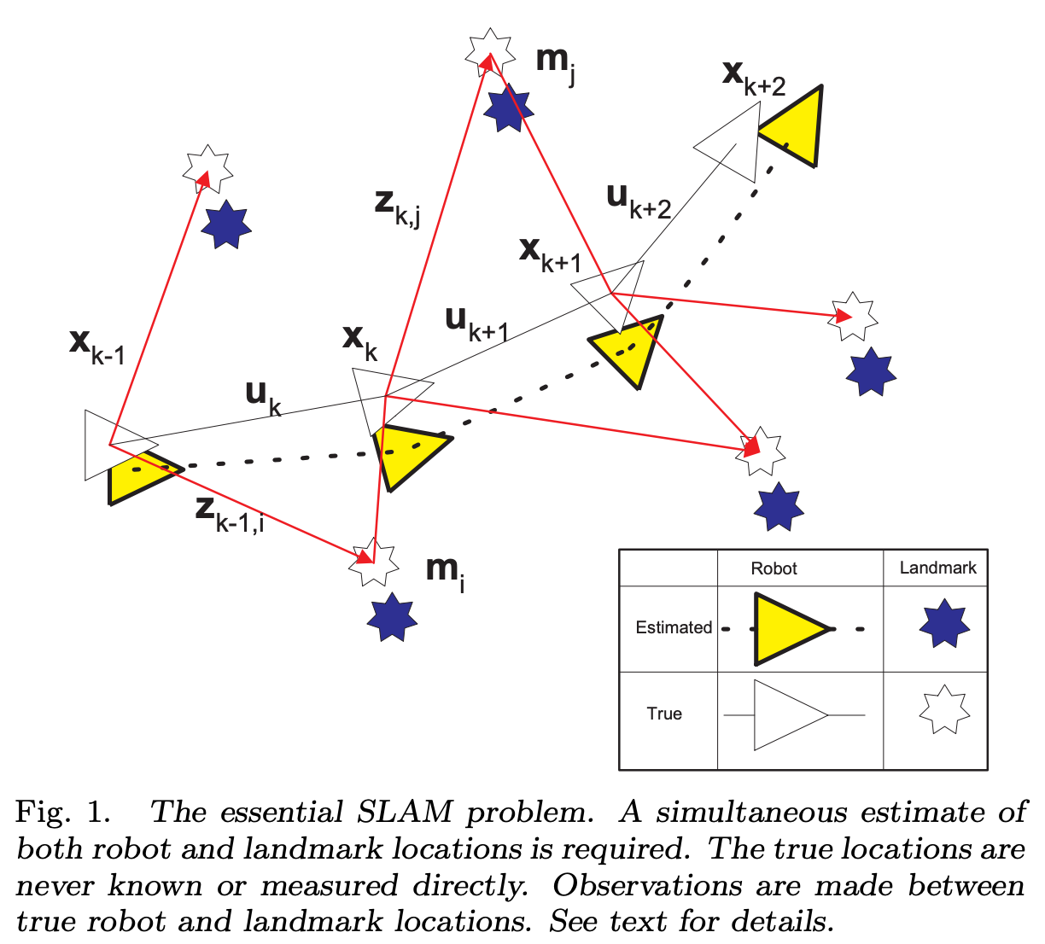
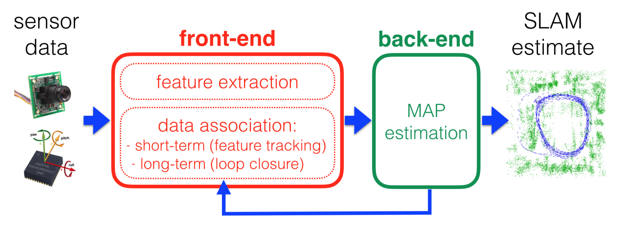
The Essential Problem

Slide 10
First: Is This a Solved Problem?
Yes, for many applications.
No, for:
Dynamic, safety critical environments;
GPS-denied outdoor environments;
Edge computation for low bandwidth field deployments;
Power, compute efficiency;
“Active” SLAM;
Efficient cooperative SLAM with multi-robot systems

Slide 11
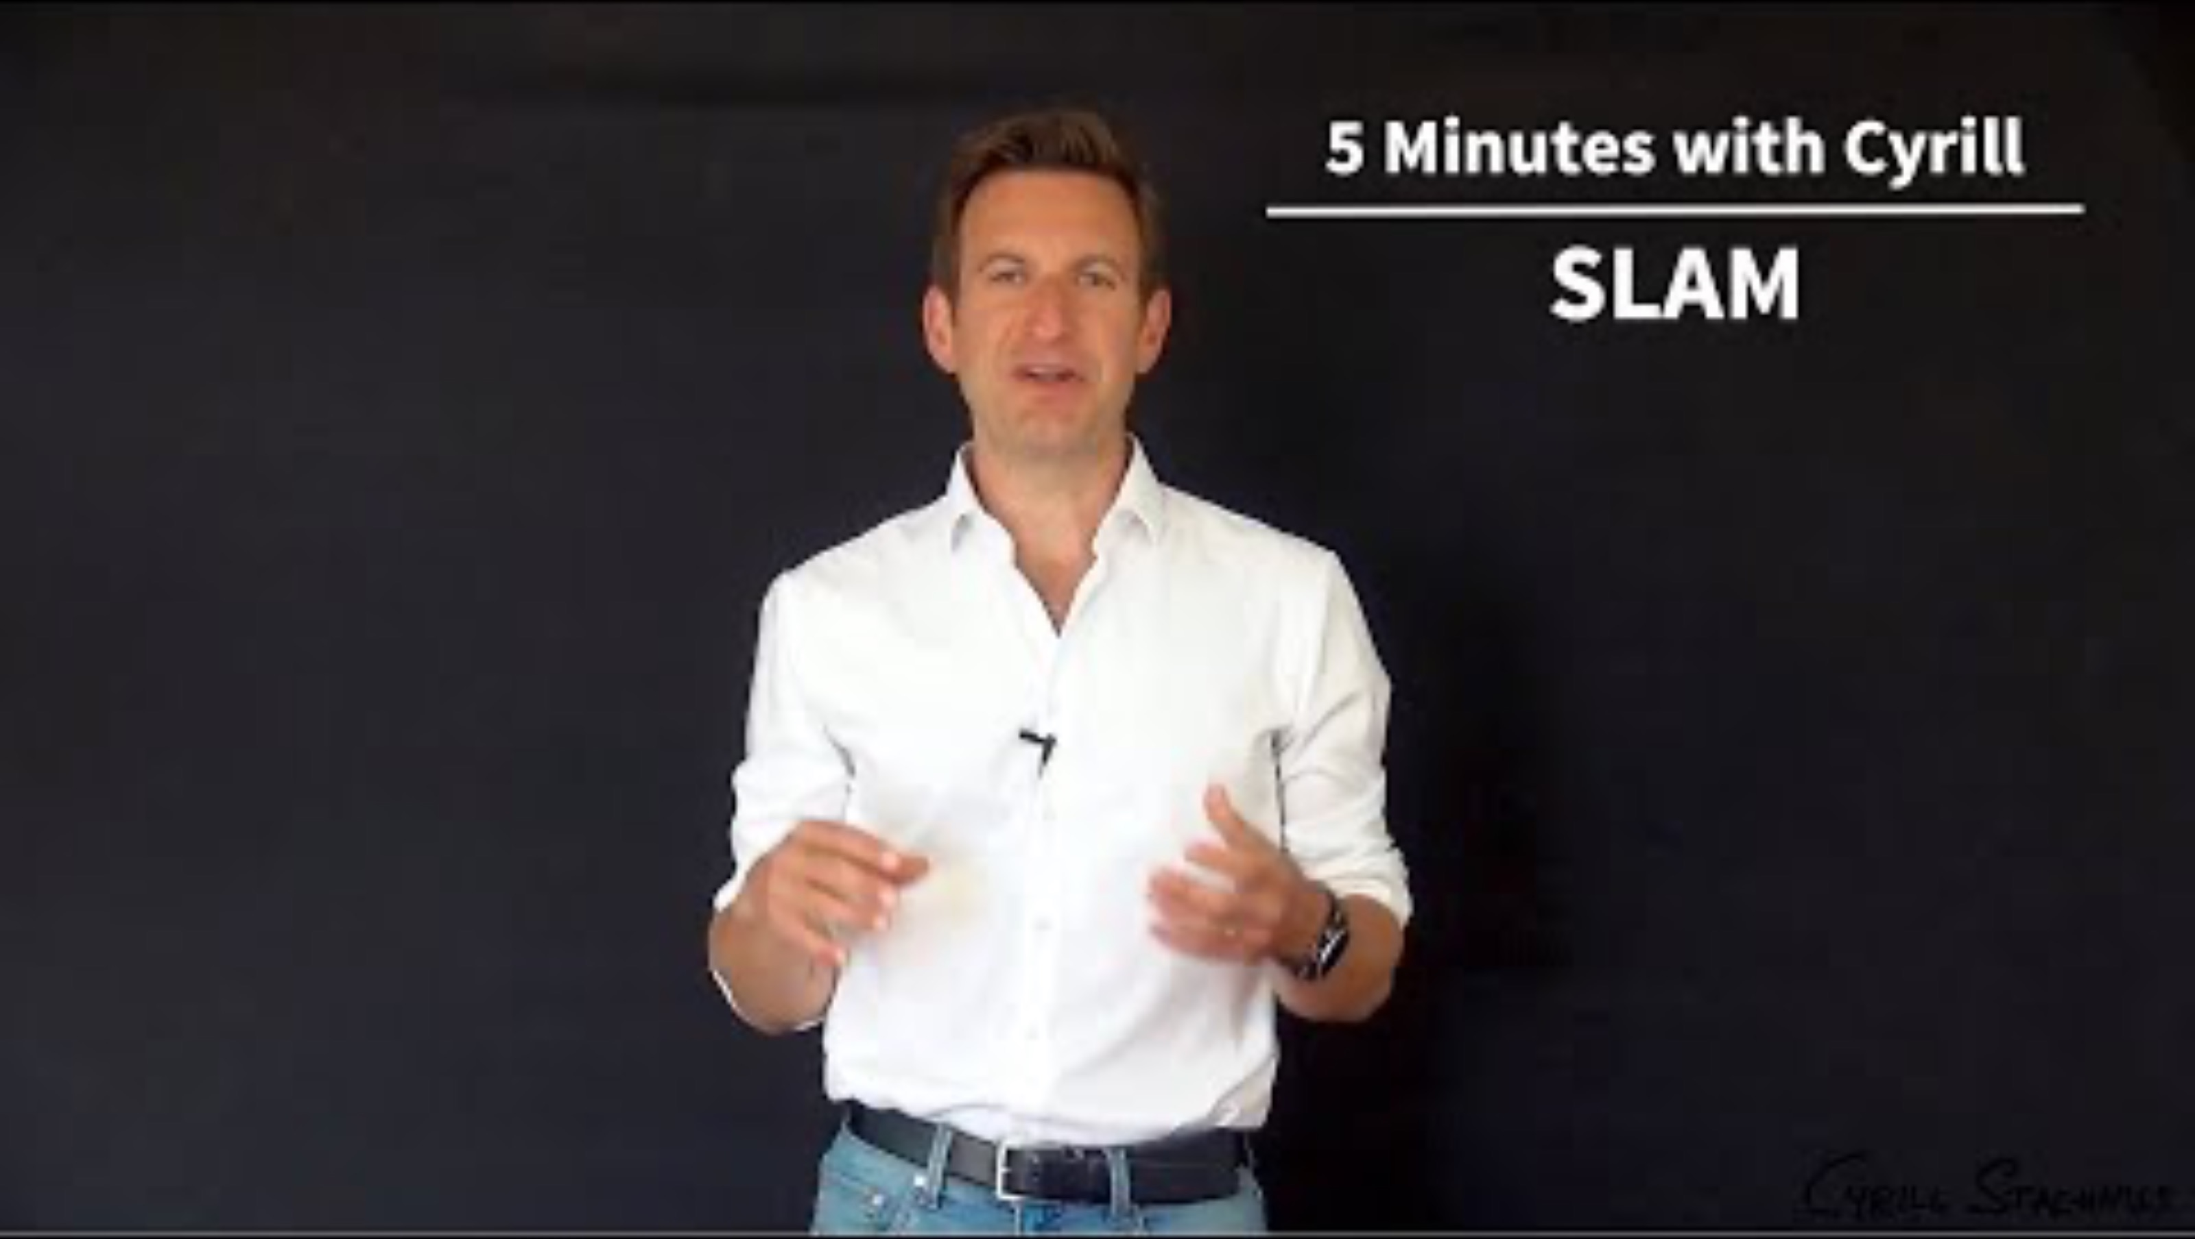
Video: Types of SLAM (Cyrill)
2:11

Slide 12
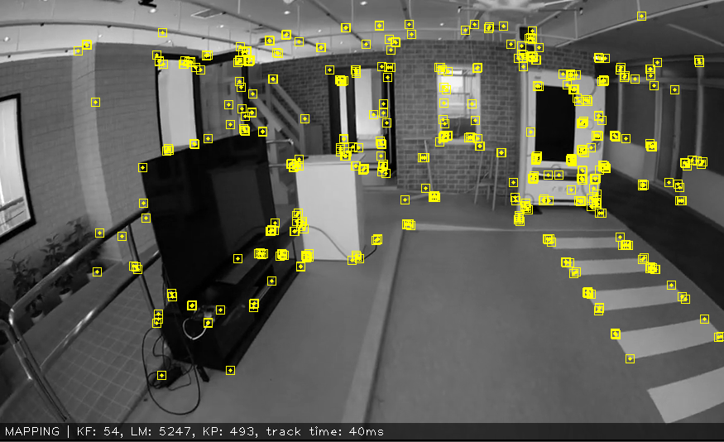
SLAM Approaches
Filter-based SLAM
Kalman filter (EKF, UKS)
Particle filter
Graph-based SLAM
GraphSLAM
Visual Slam (V-SLAM)
ORB-SLAM
Gmapping
Deep Learning-based SLAM
LIFT
EnvSLAM

Slide 13
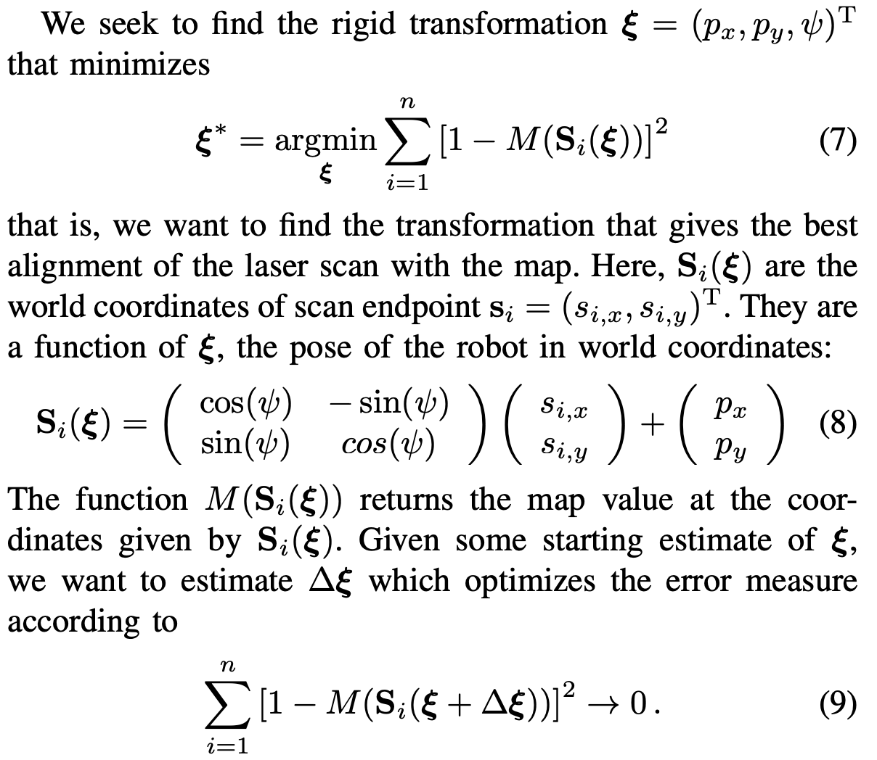
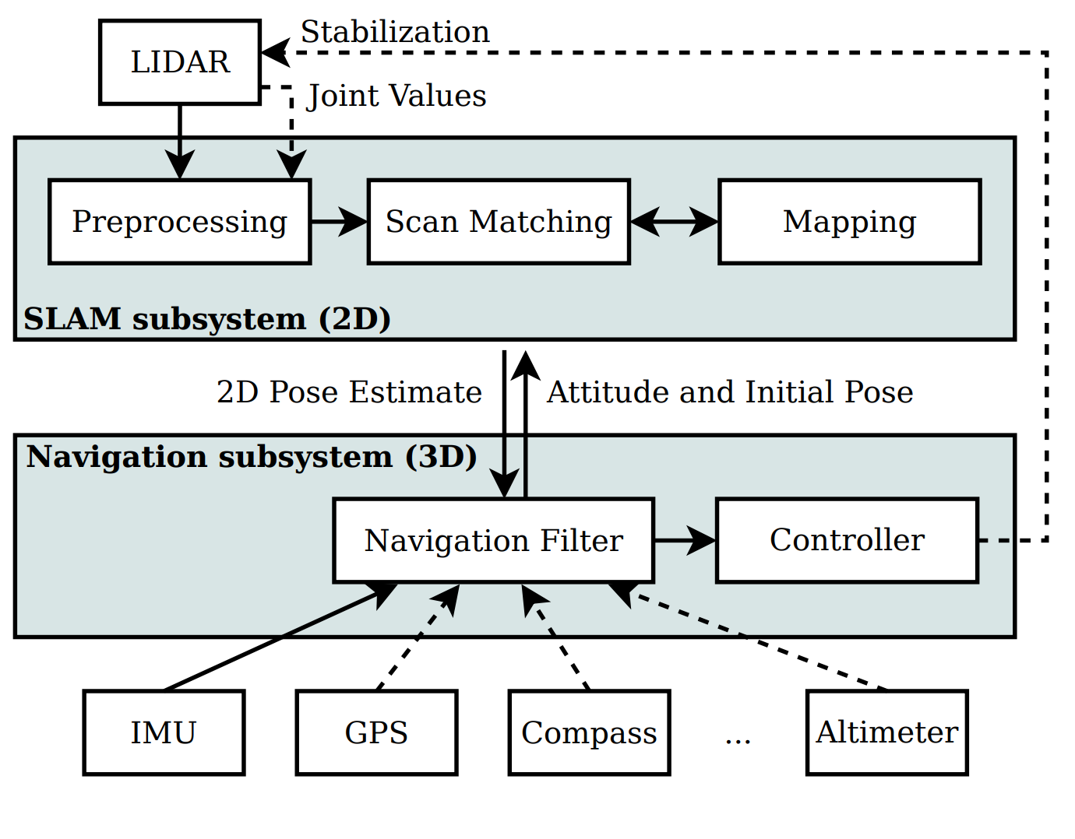
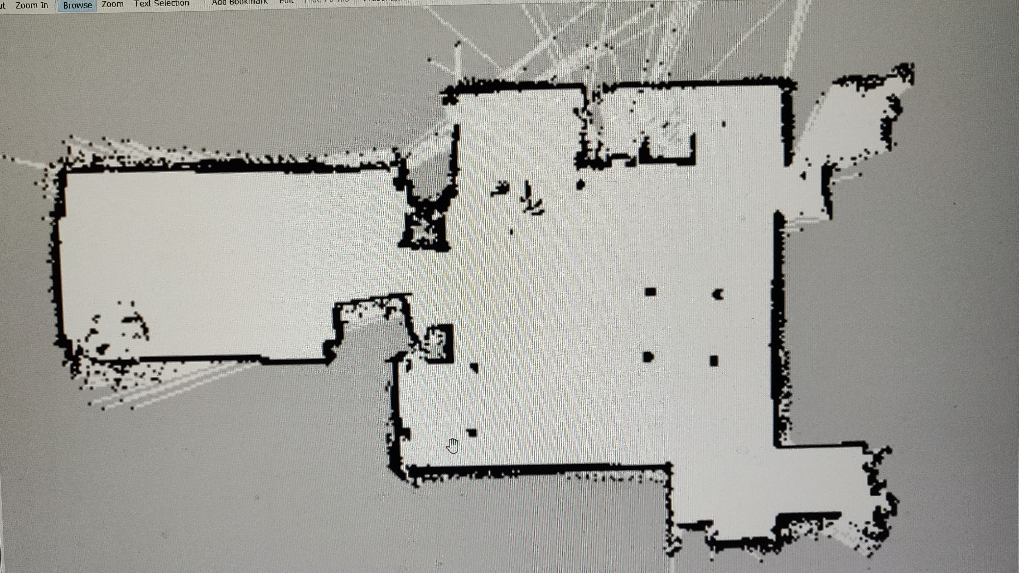
SLAM with Point Clouds (e.g., LiDAR)
Hector SLAM:
common for small LiDAR robots (e.g., TurtleBot)

Slide 14
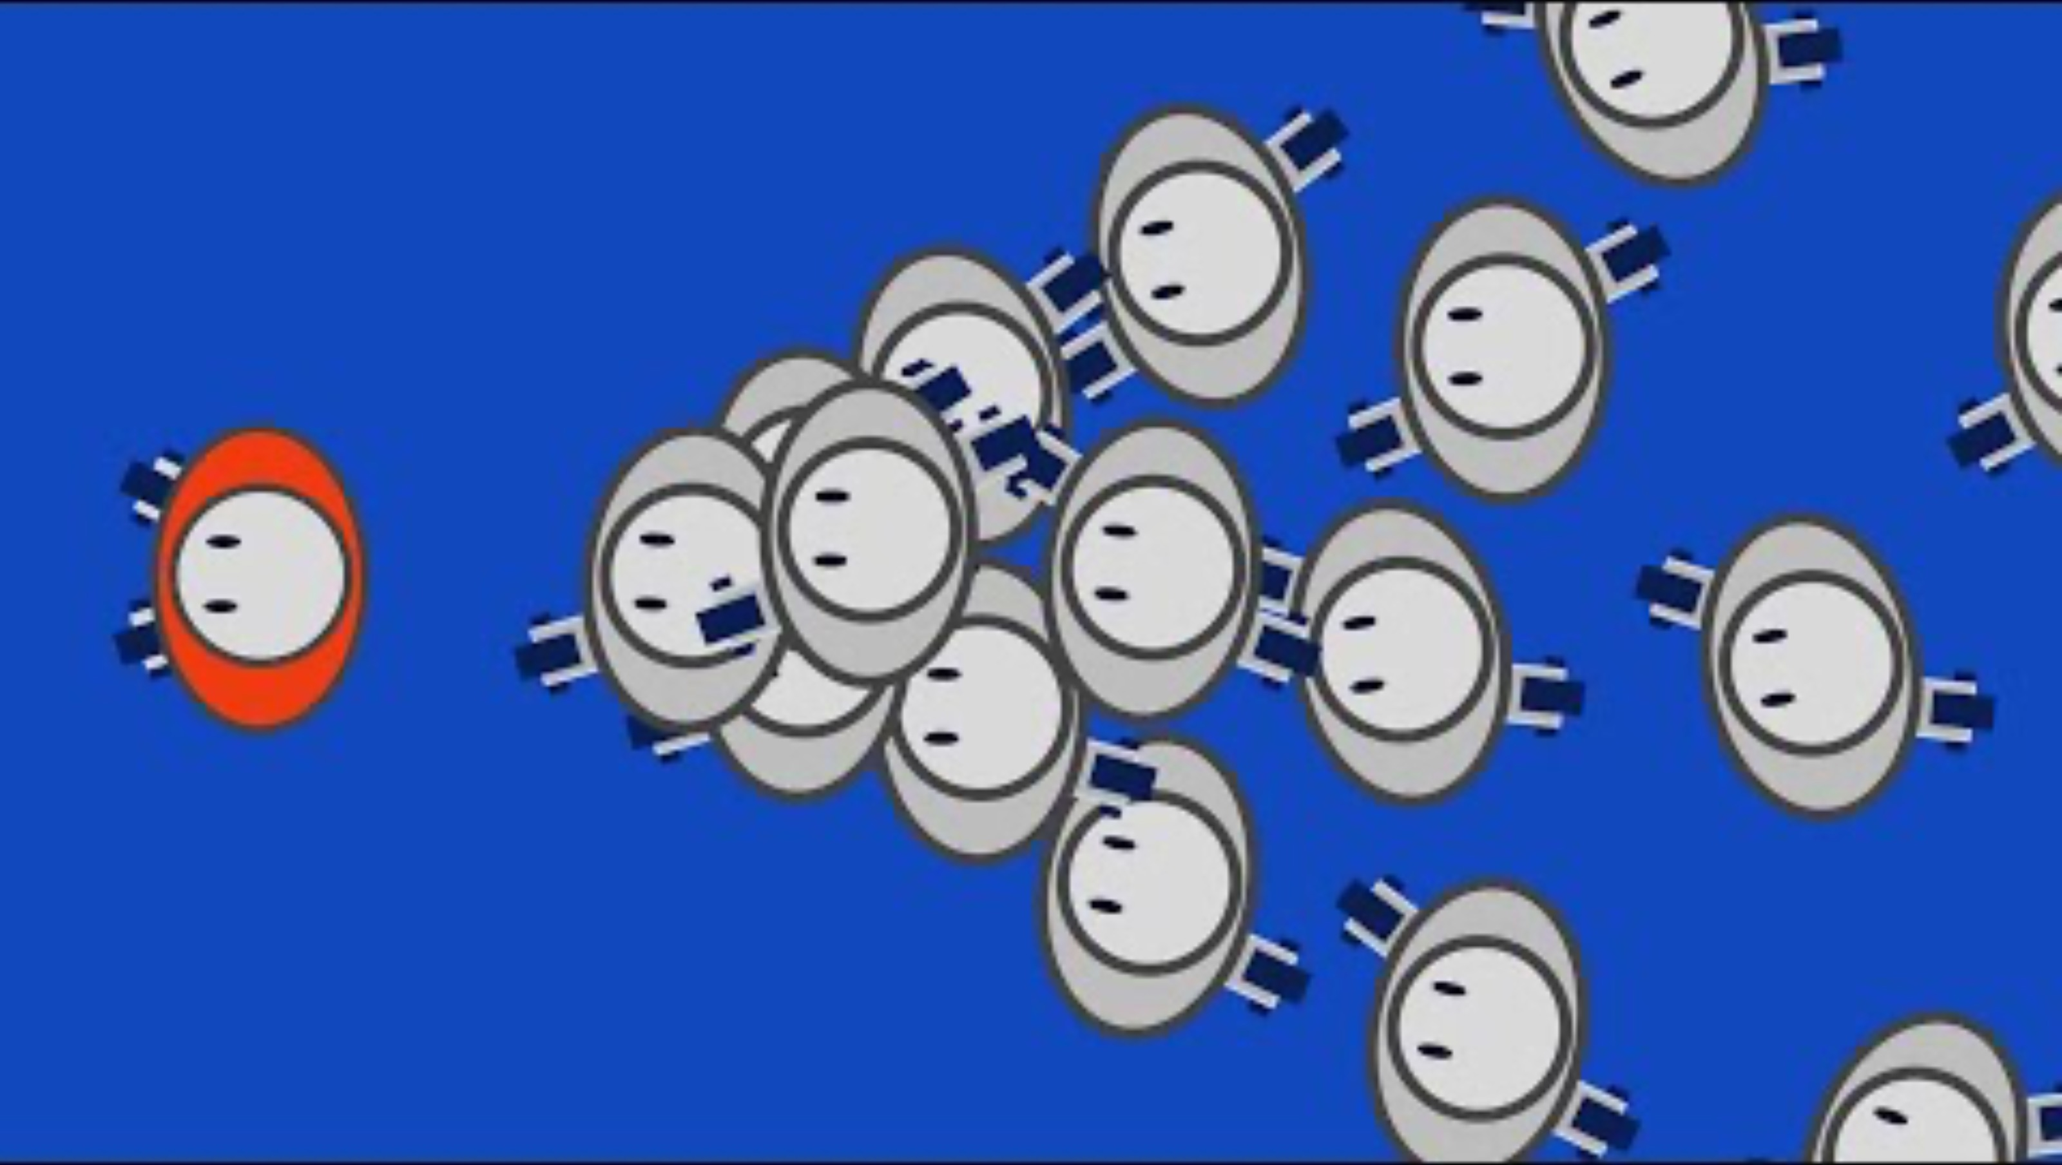
SLAM with Point Clouds (e.g., LiDAR)

Slide 15
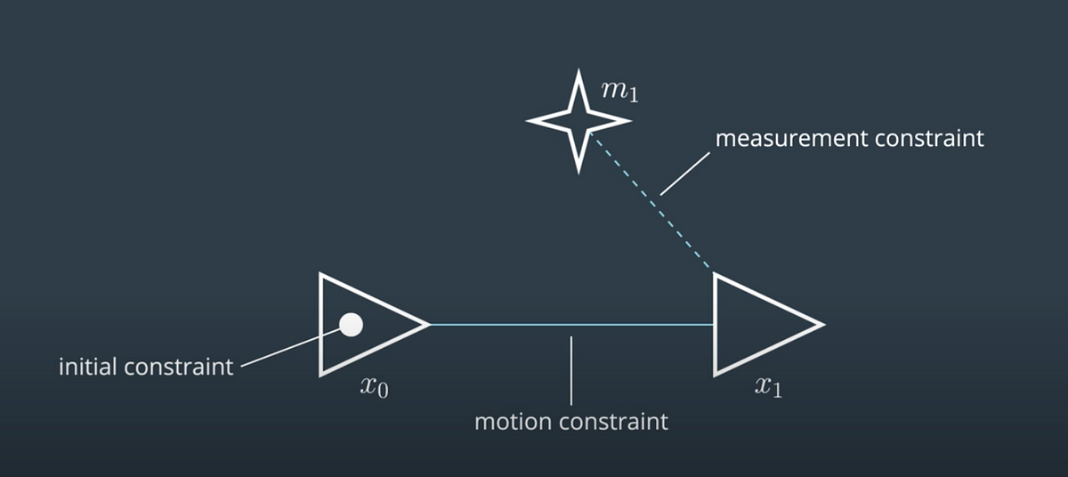
Graph SLAM
Key points to reduce uncertainty:
Our real motion (traversal from pose to pose) is constrained by physics
Our real measurements are constrained by physics

Slide 16
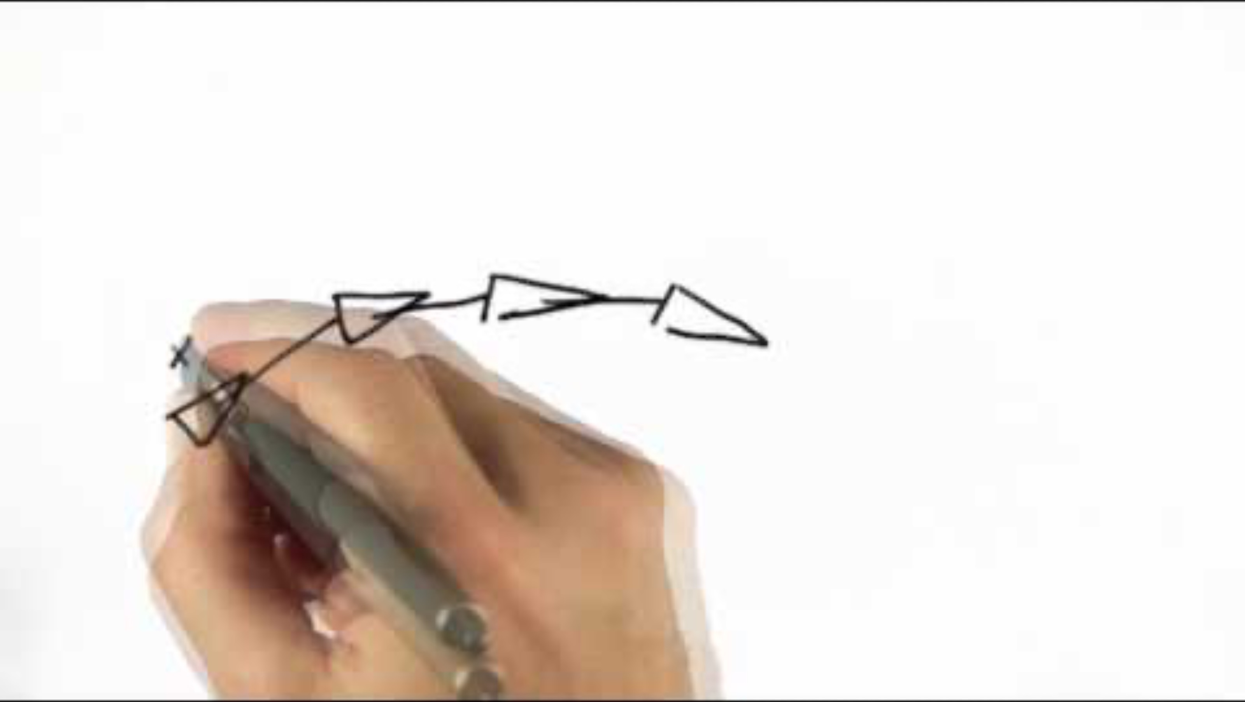
Graph SLAM

Slide 17
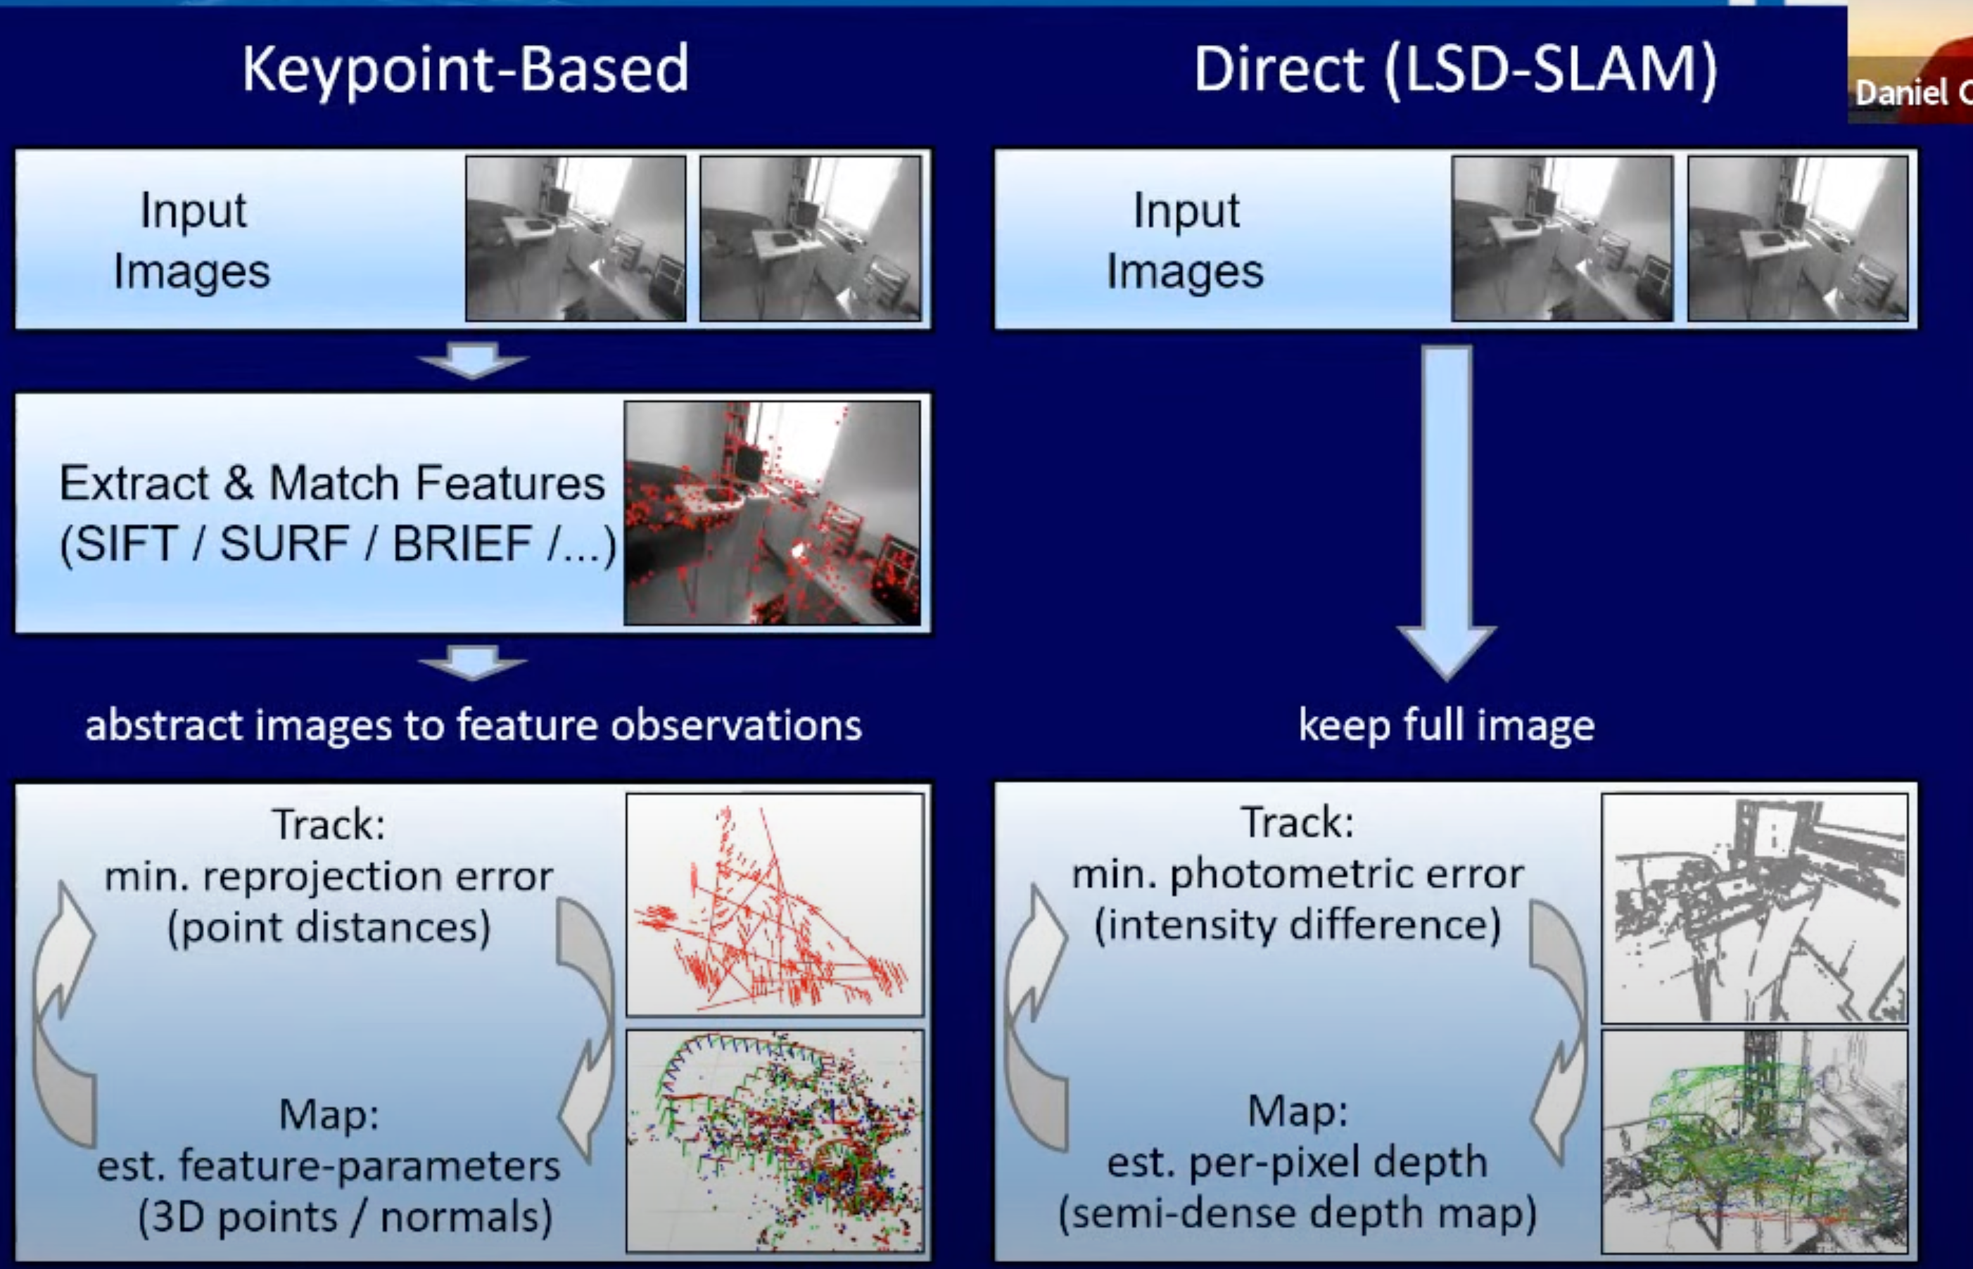
SLAM with Cameras (VSLAM)

Slide 18
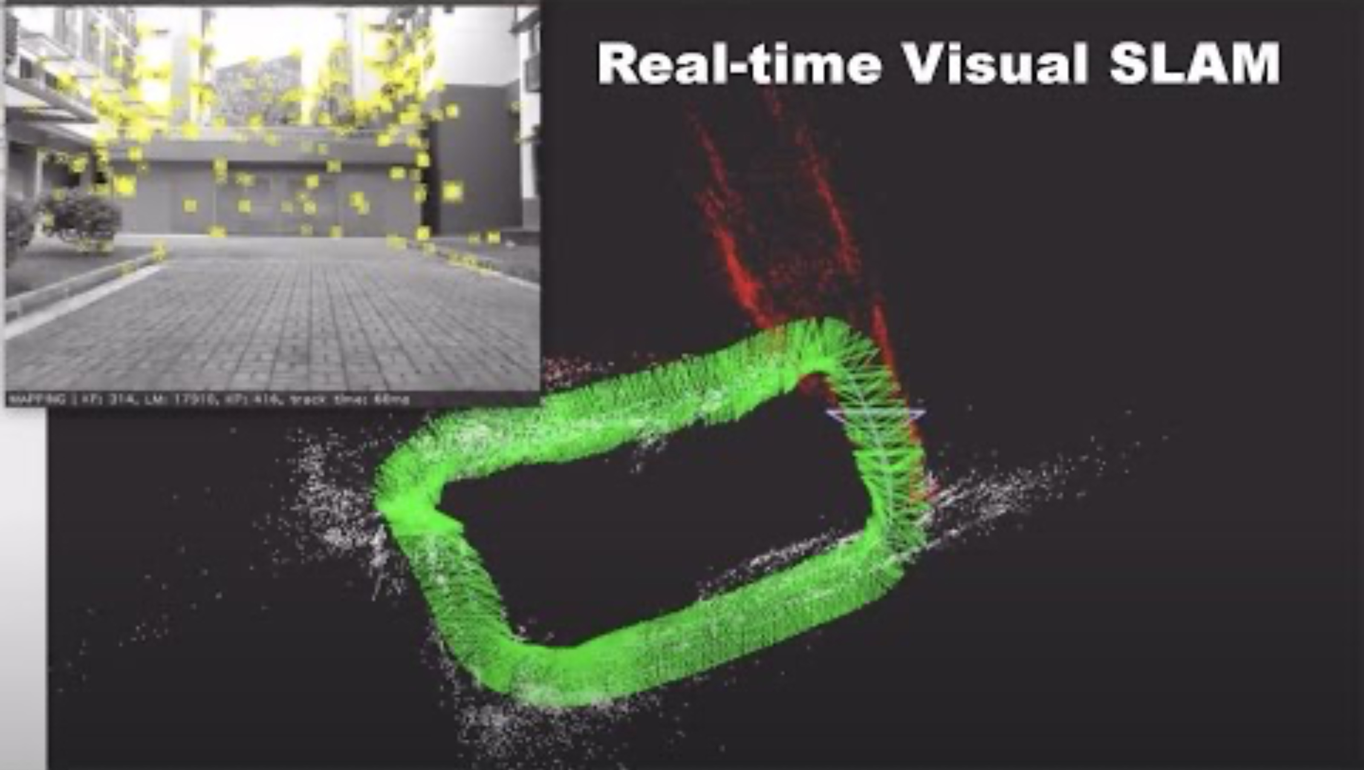
SLAM with Cameras (VSLAM)
1:38

Slide 19
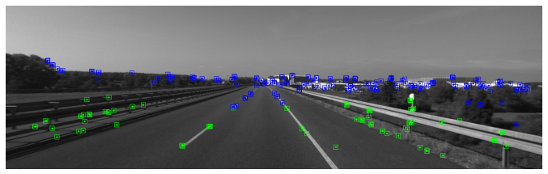
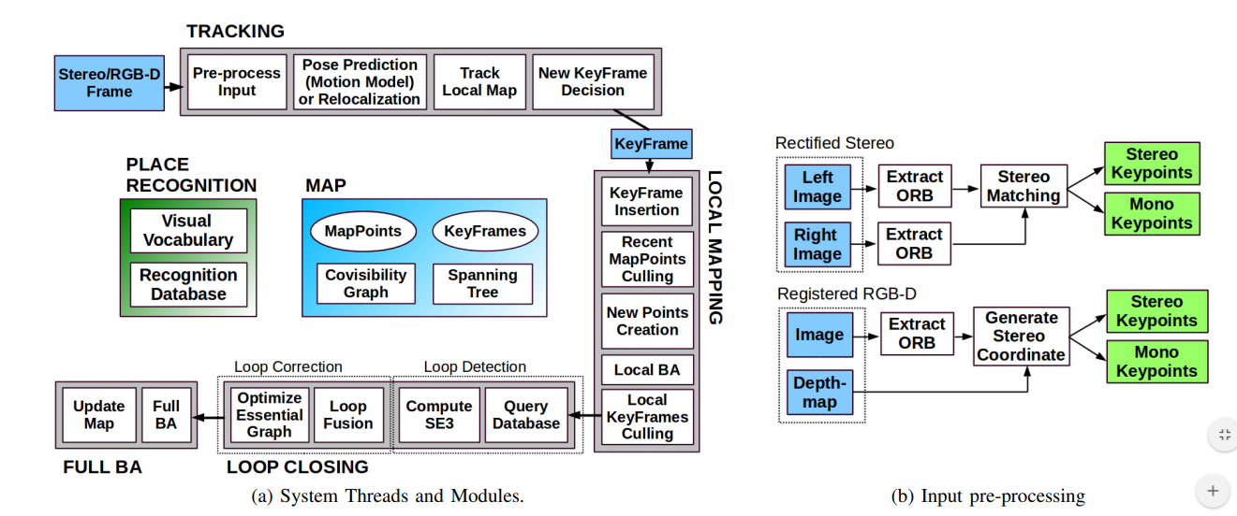
ORBSlam
Tracking: frame-by-frame feature matching with local map
Local mapping: Create local map, Bundle Adjustment (BA) (estimates camera position relative to image)
Loop closure: Pose graph optimization for local map merging

Slide 20
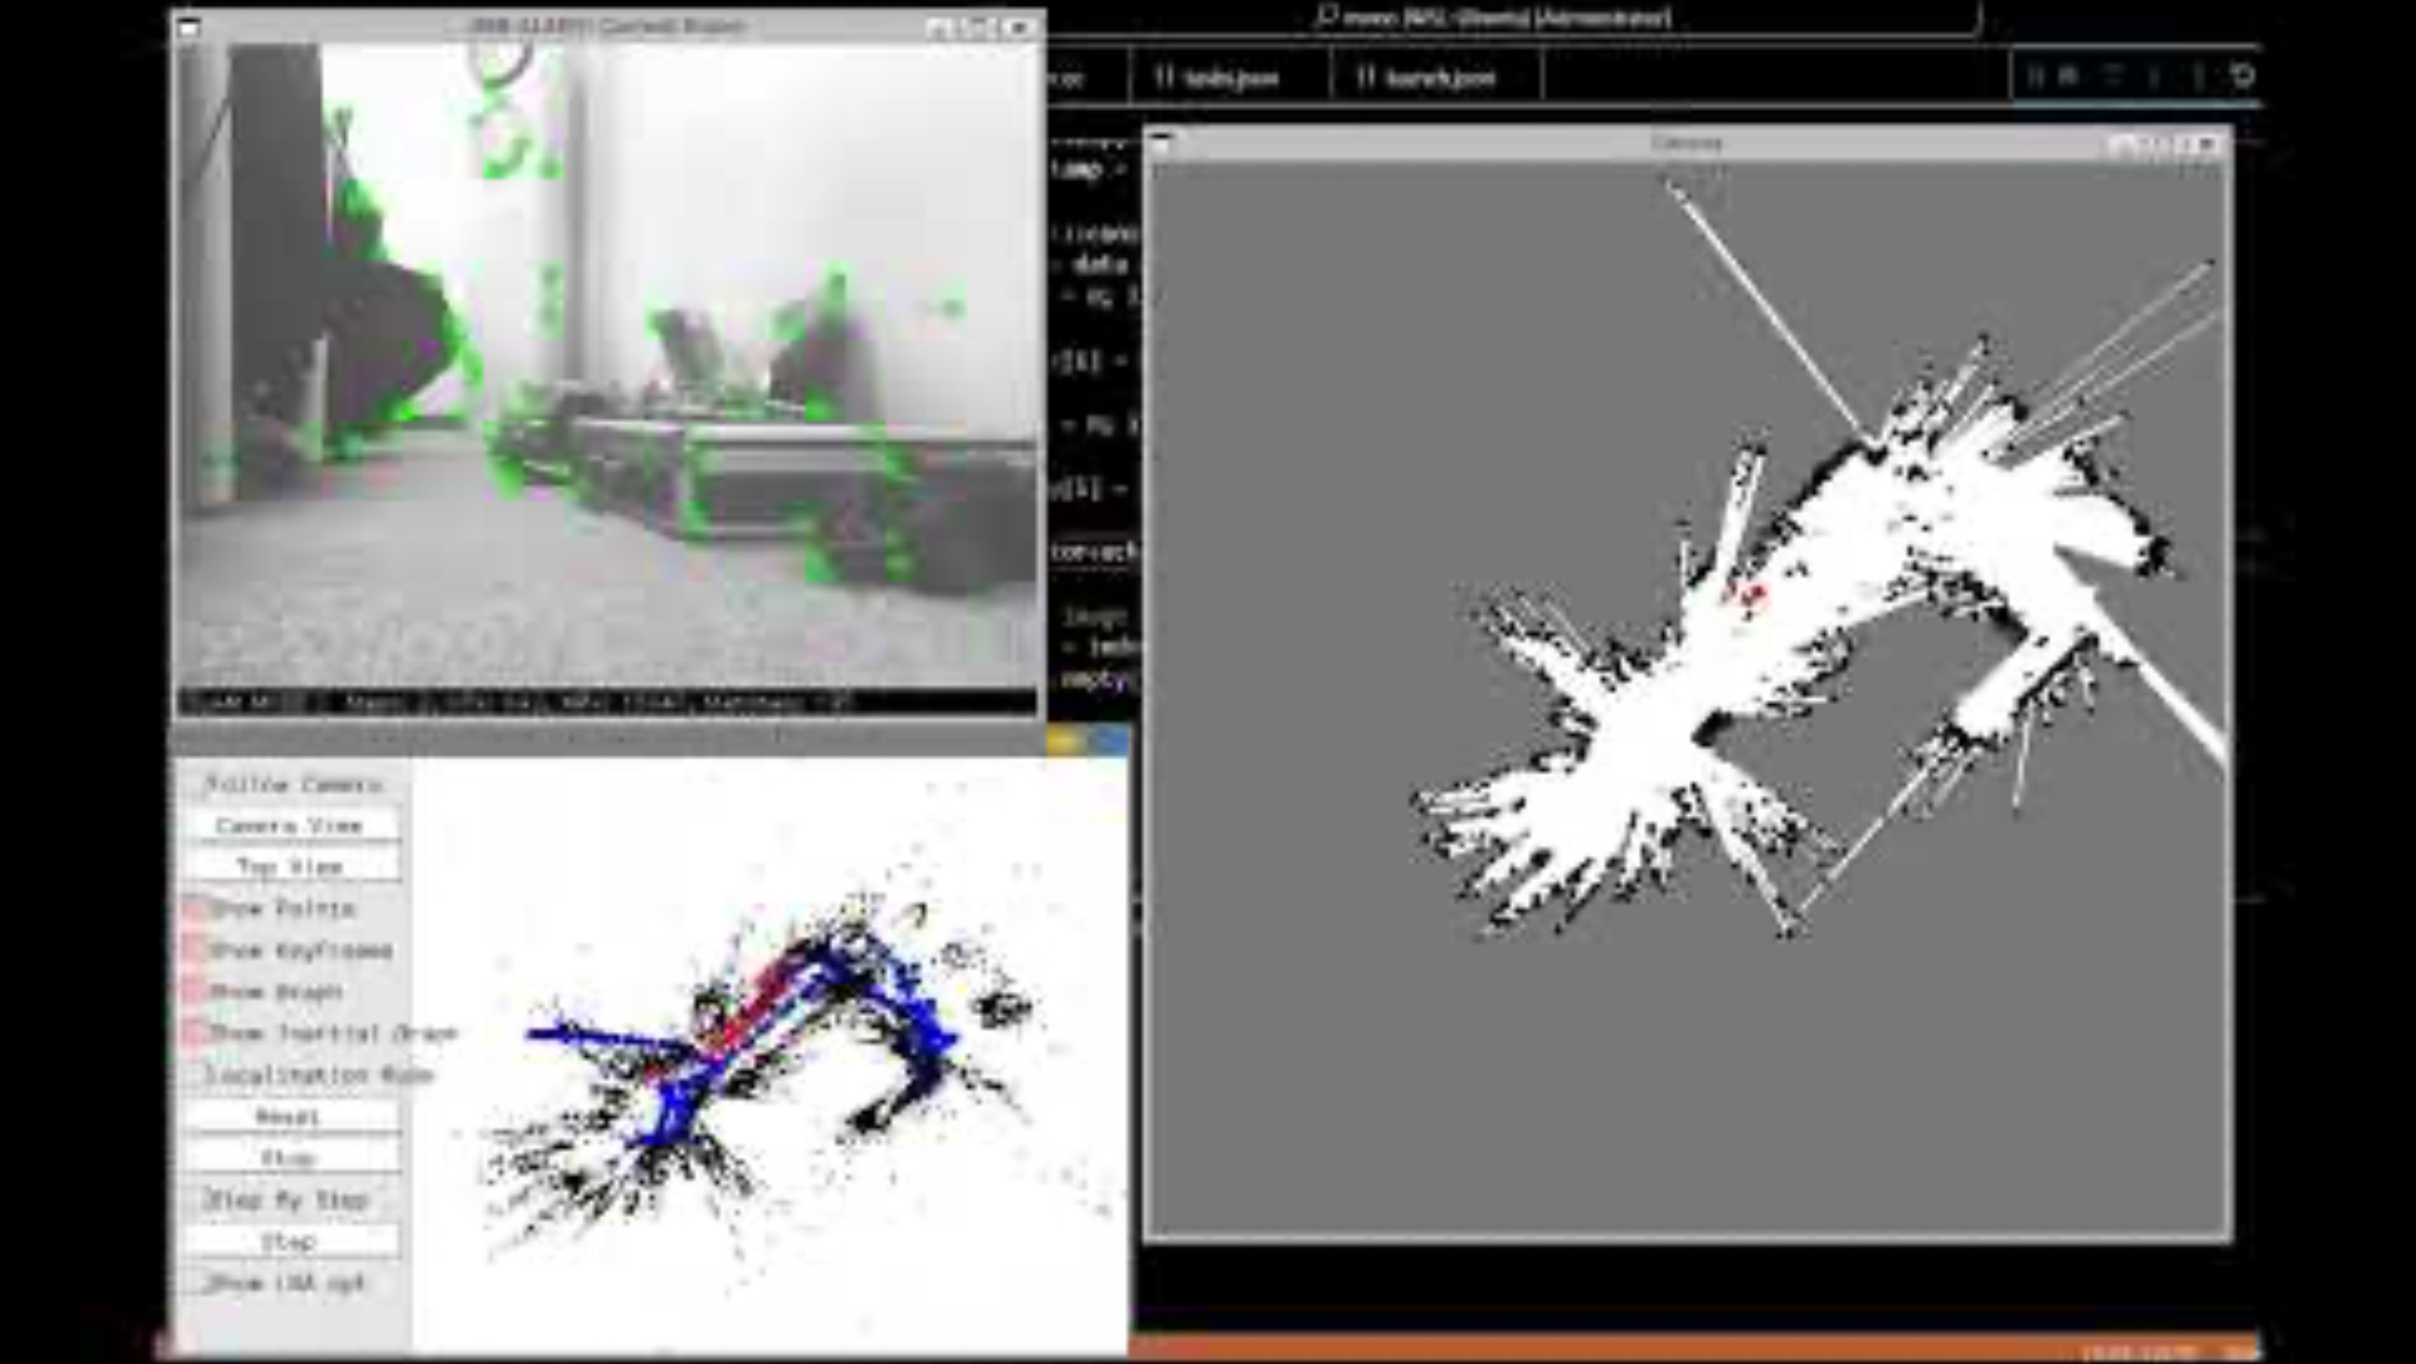
ORBSlam video

Slide 21
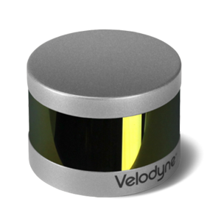
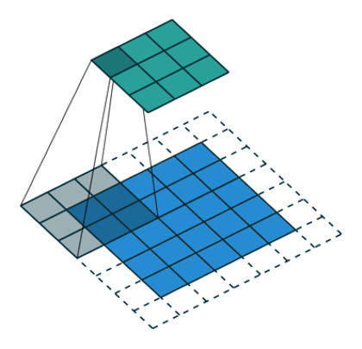
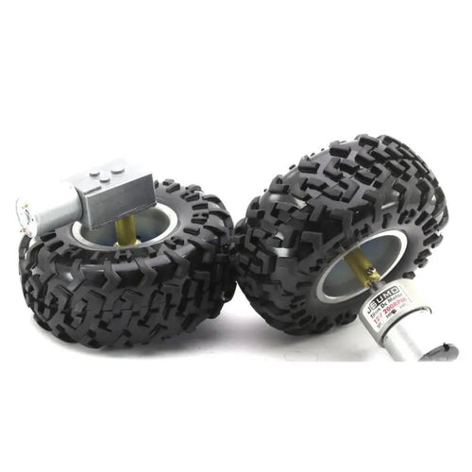
Three Pillars
Action
Perception
Intelligence
(not just moving)
(not just sensing)
(not just classification)

Slide 22
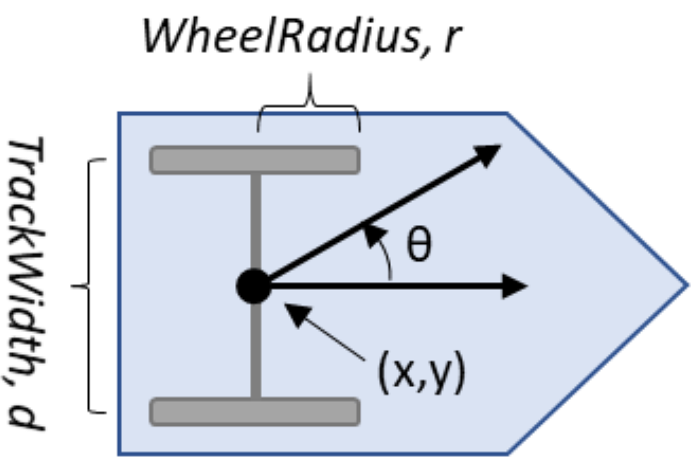
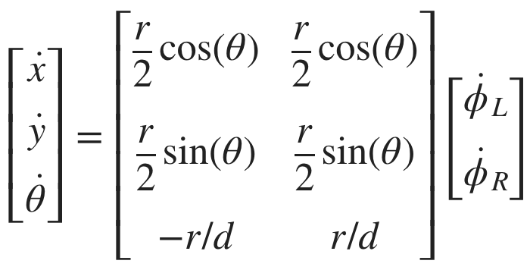
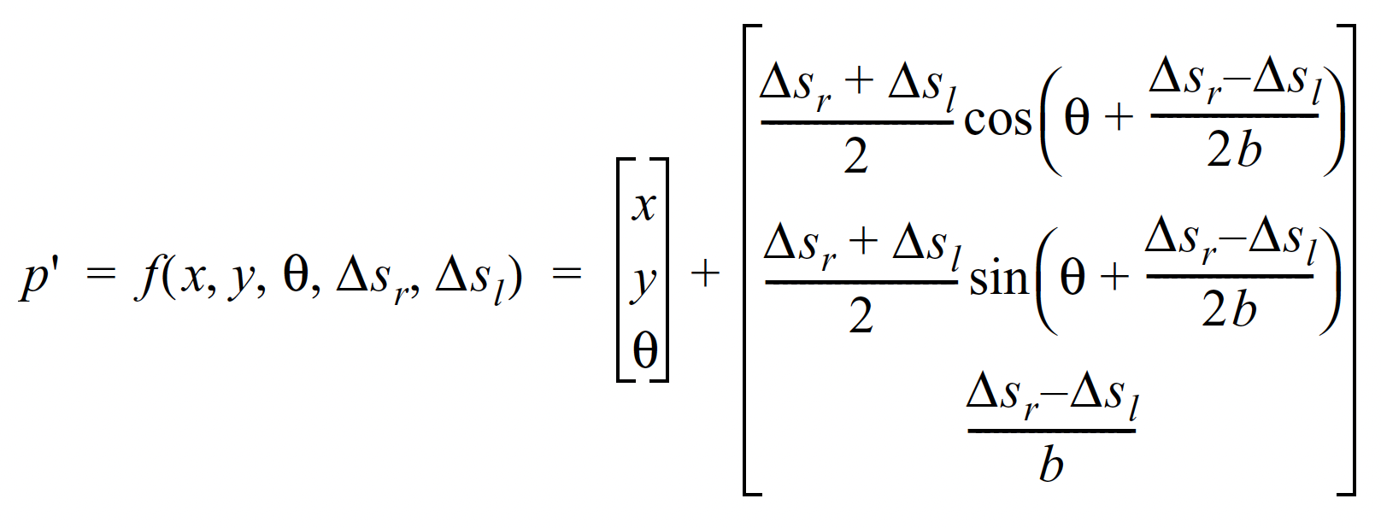
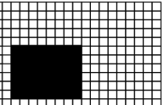
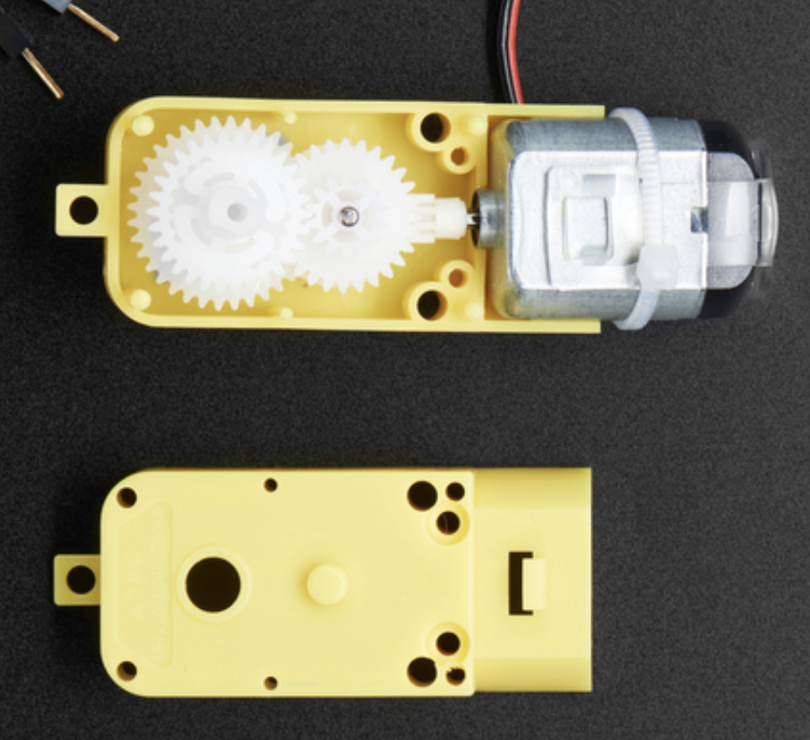
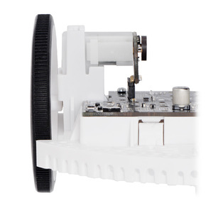
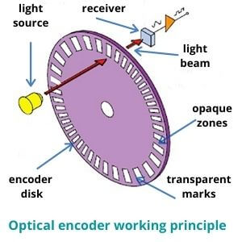
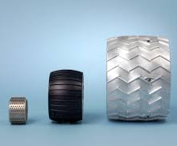

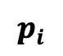
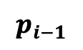

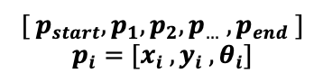
Action: End-to-End Overview
series of poses
$${[ p}_{start}, p_{1},p_{2},p_{…} , p_{end} ]$$
$$p_{i}=[x_{i} , y_{i} , θ_{i}]$$
$$p_{i−1}$$
Path Planning
$$p_{i}$$
Kinematics
desired $Δs_{r} , Δs_{l}, θ$
physical
parameters
$$Δs=\frac{Δenc}{CPR∗gr}∗c_{wheel}$$
Motor
Wheel
Encoder
Odometry

Slide 23
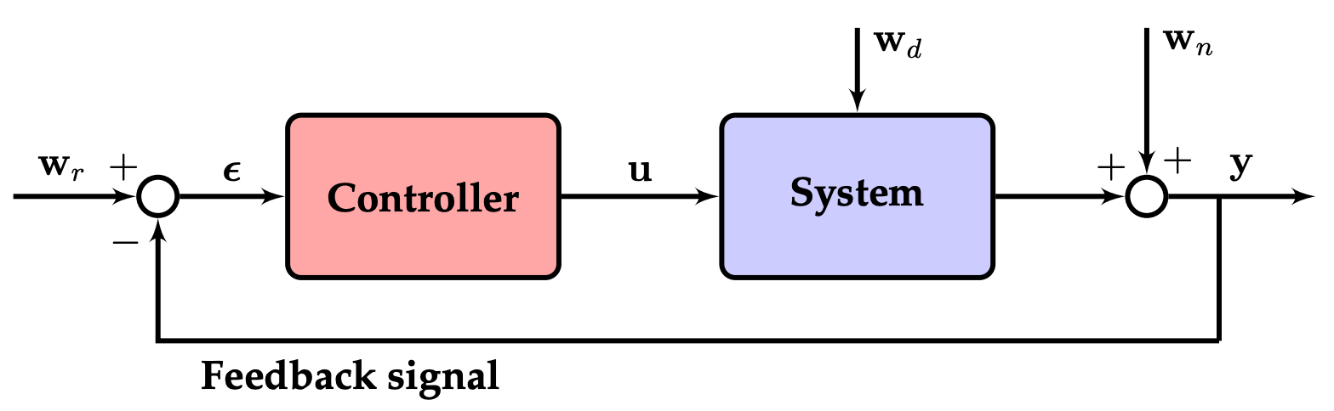
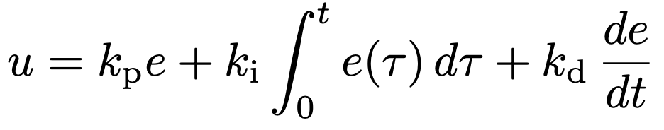

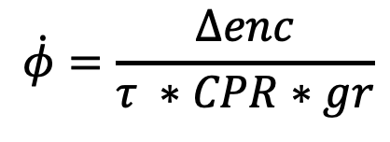
Action: End-to-End Overview
$$Δs=\frac{Δenc}{CPR∗gr}∗c_{wheel}$$
series of poses
$${[ p}_{start}, p_{1},p_{2},p_{…} , p_{end} ]$$
$$p_{i}=[x_{i} , y_{i} , θ_{i}]$$
Path Planning
Kinematics / Odometry
What about speed?
$$\dot{φ}=\frac{Δenc}{τ ∗CPR∗gr}$$
Easiest thing to do / assume: constant linear velocity

Slide 24
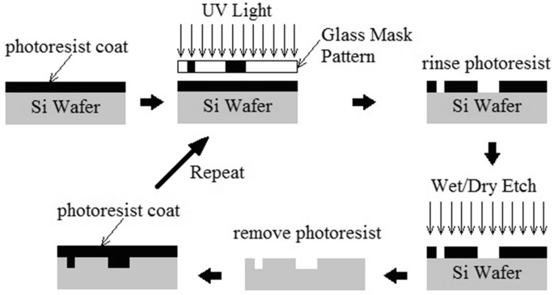

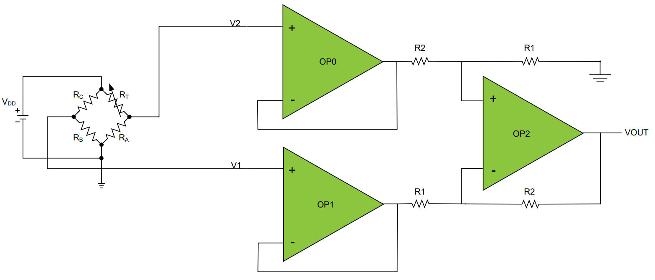
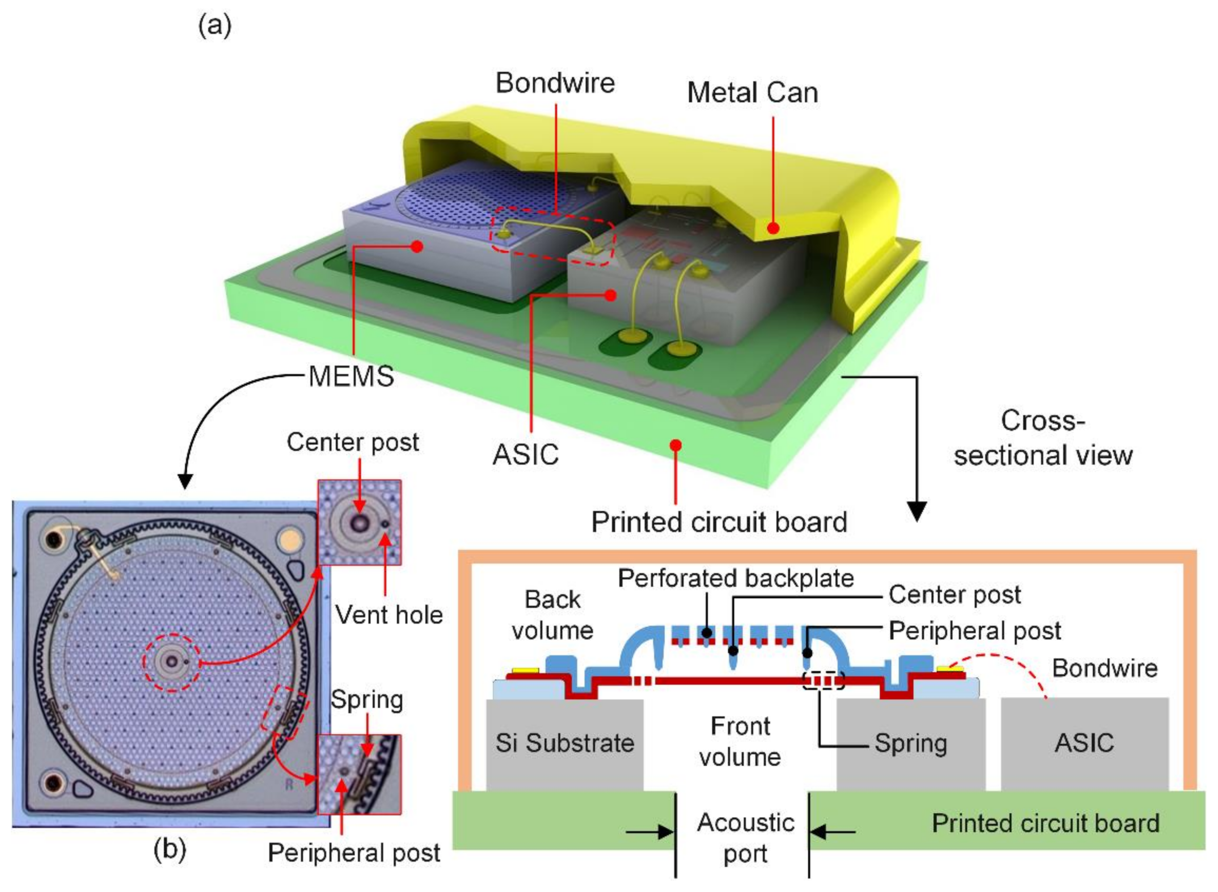
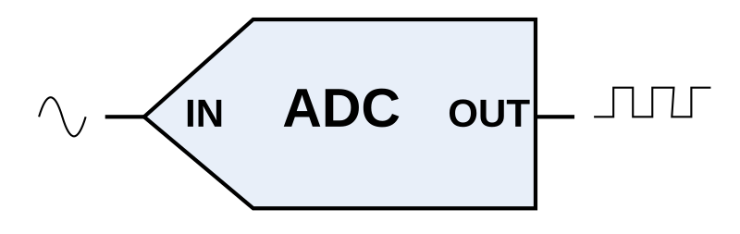



Perception Recap

Slide 25
Intelligence 1 Recap

Slide 26
Intelligence 2 Summary

Slide 27
Lecture (~45 minutes)
Subsystem check-in (~15 minutes)
Questions?
Questions?
Lecture 1: features, transformations, and mapping
Lecture 2: SLAM

Slide 28

693H Robotic Subsystems
-Second Design Review Presentations are 3/10, 3/12
-You will be expected to have functional prototypes complete to show by then
-You will be expected to have PCB designs and final BoMs complete by then
(leaves time for manufacture, shipping, assembly, and one more iteration if necessary)
Astound-the-Class 2 is scheduled for MONDAY, MARCH 3rd

